Slide 1



The past of a quantum particle
Lev Vaidman

Slide 2
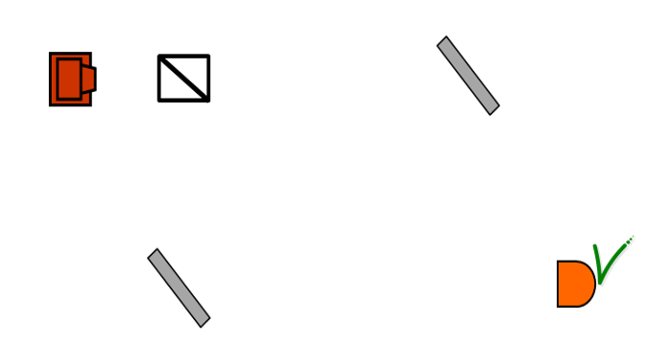
Where was a pre- and post-selected particle?

Slide 3
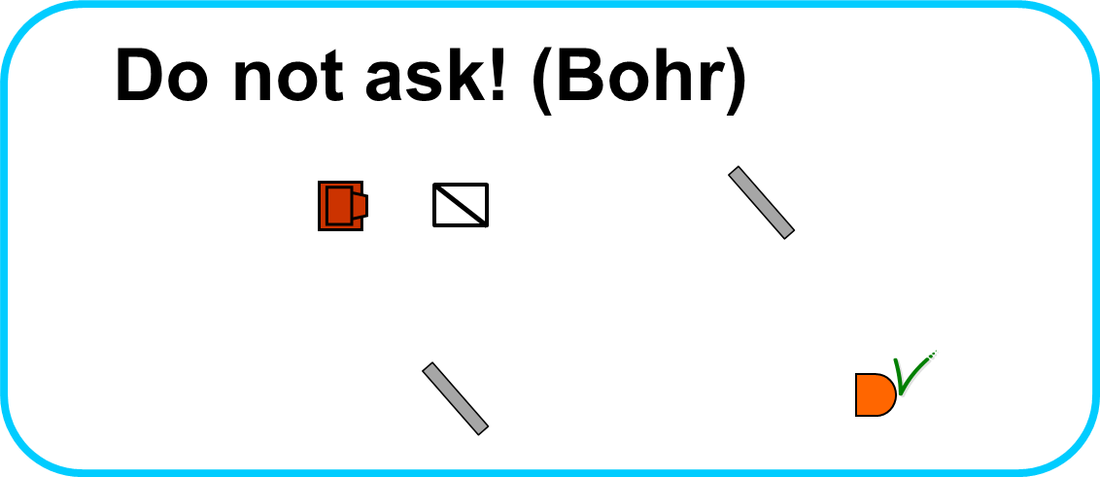
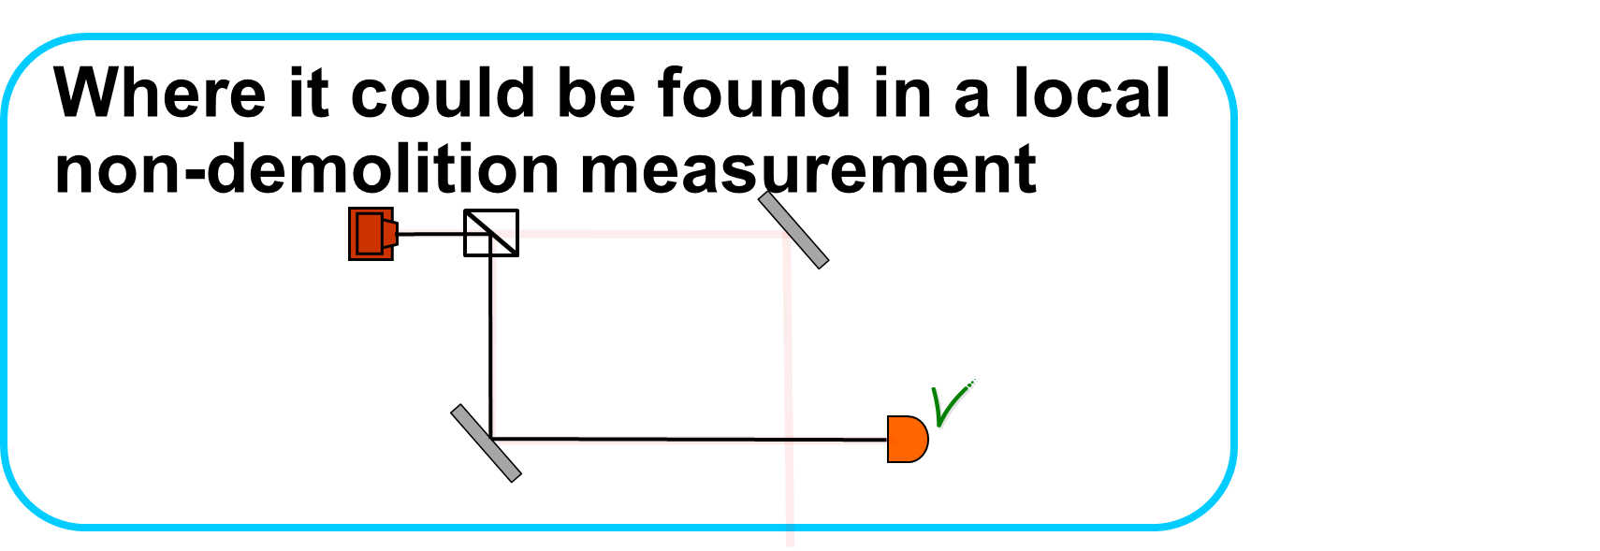
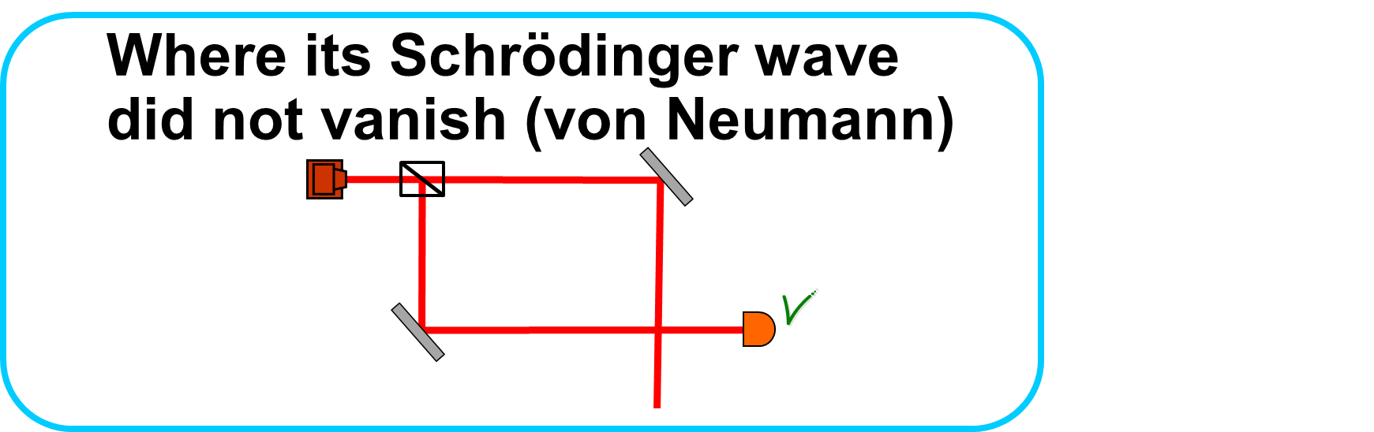
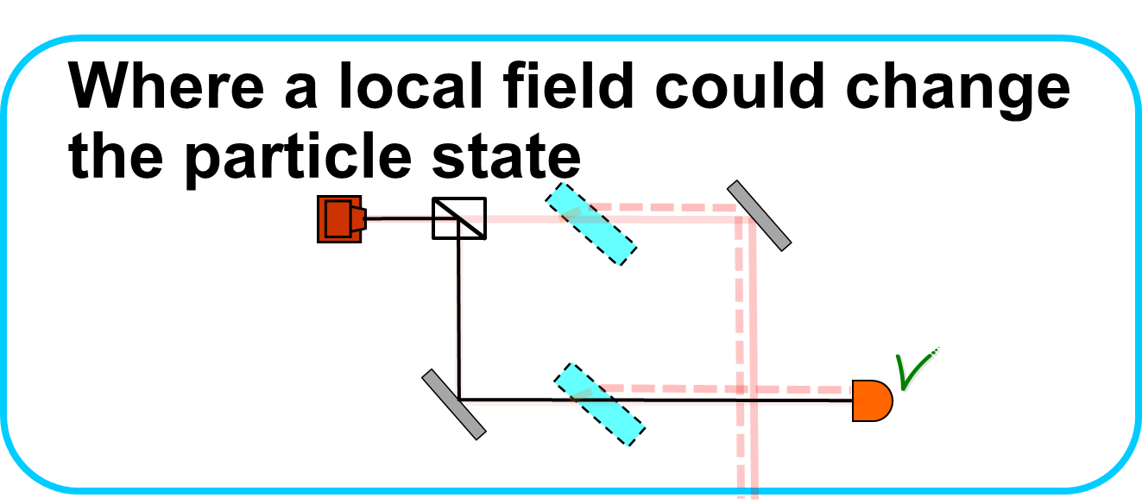
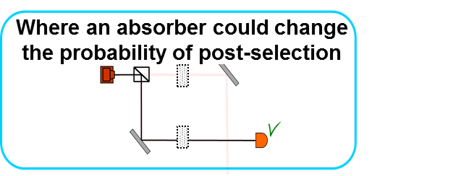
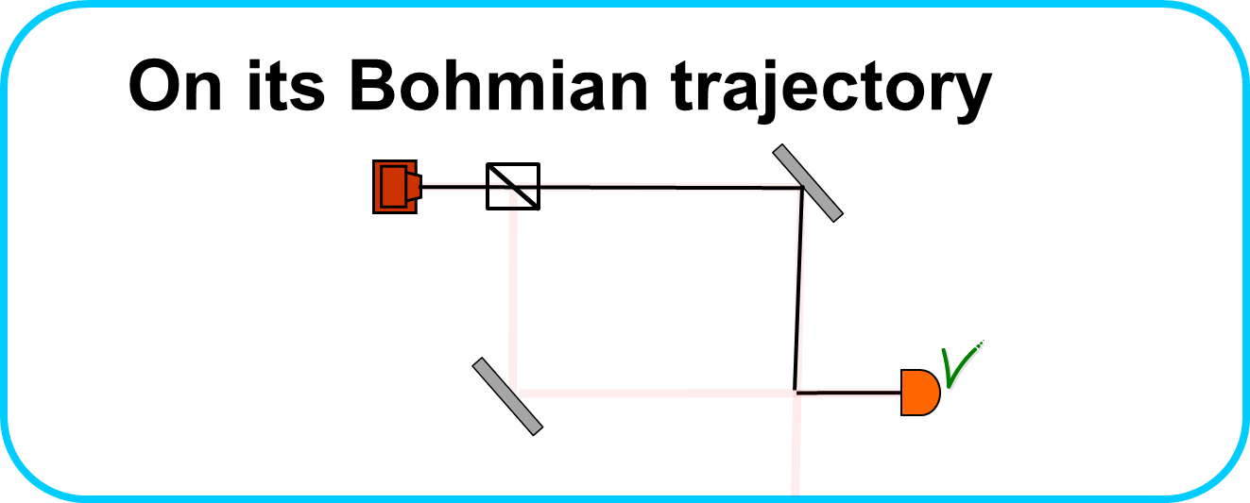
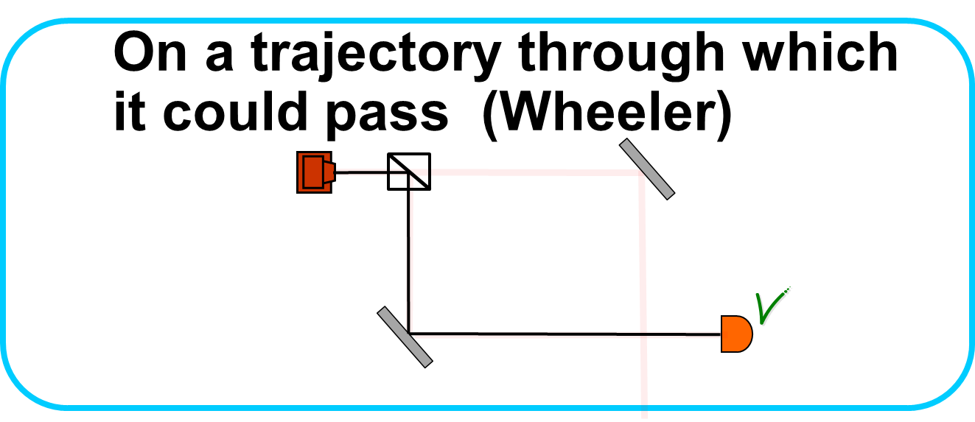
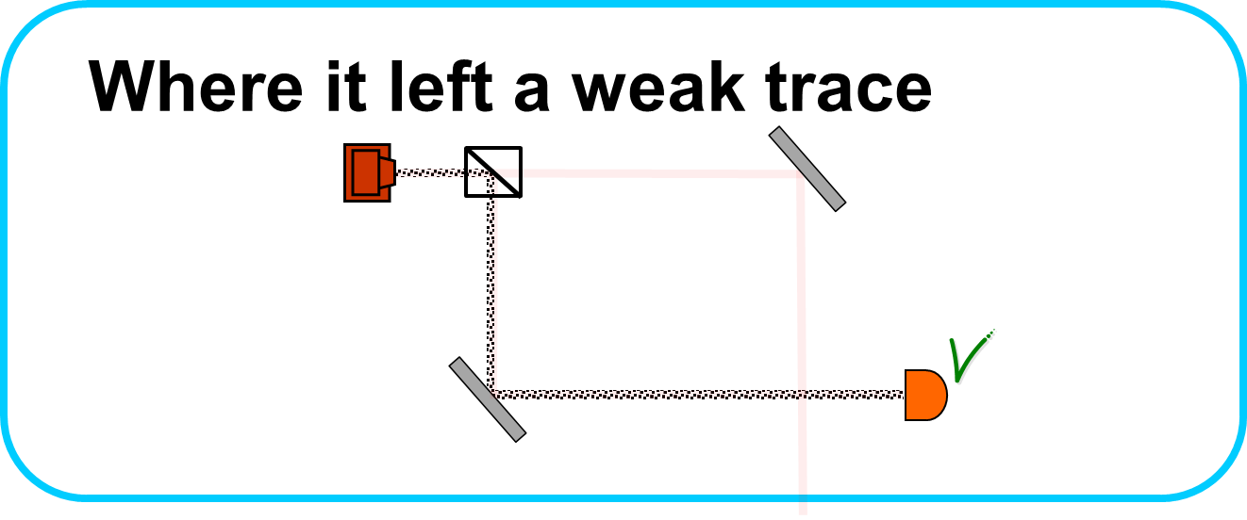
Where was a pre- and post-selected particle?

Slide 4


Where was a pre- and post-selected particle?

Slide 5

Where was a pre- and post-selected particle?

Slide 6

Where was a pre- and post-selected particle?

Slide 7

Where was a pre- and post-selected particle?

Slide 8
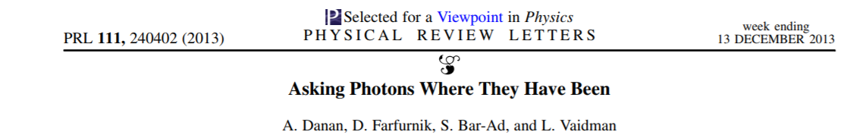
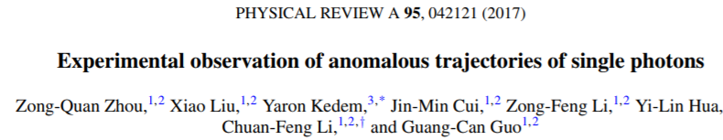
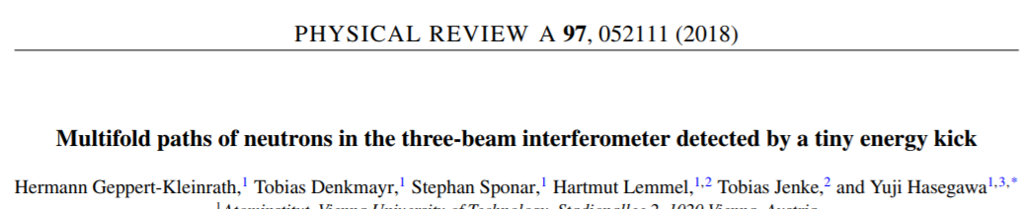
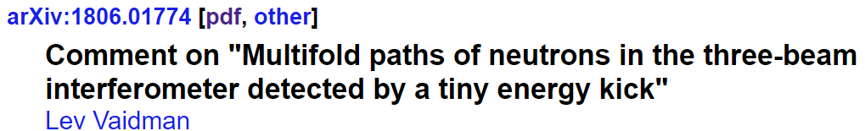
Where was a pre- and post-selected particle?

Slide 9
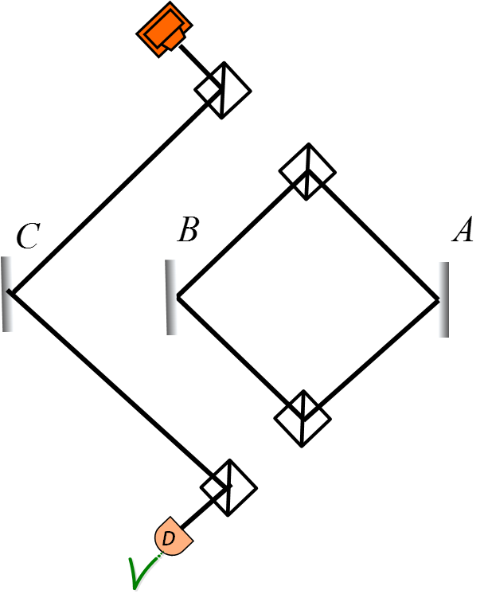
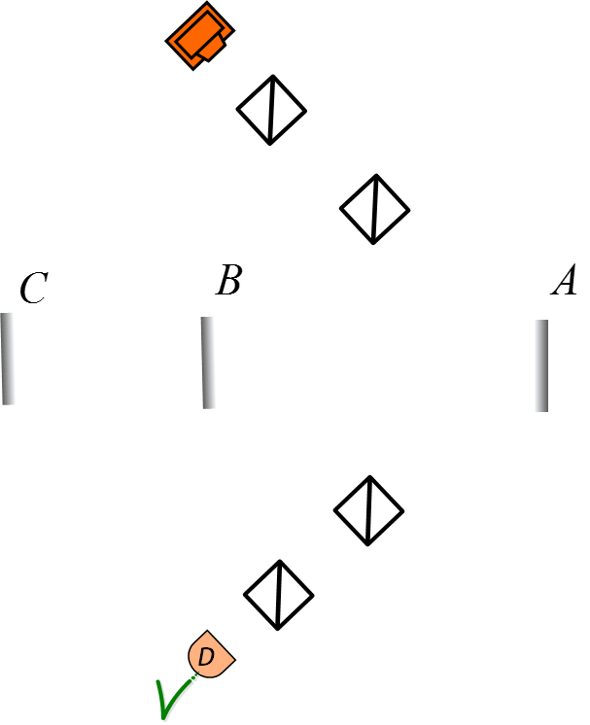
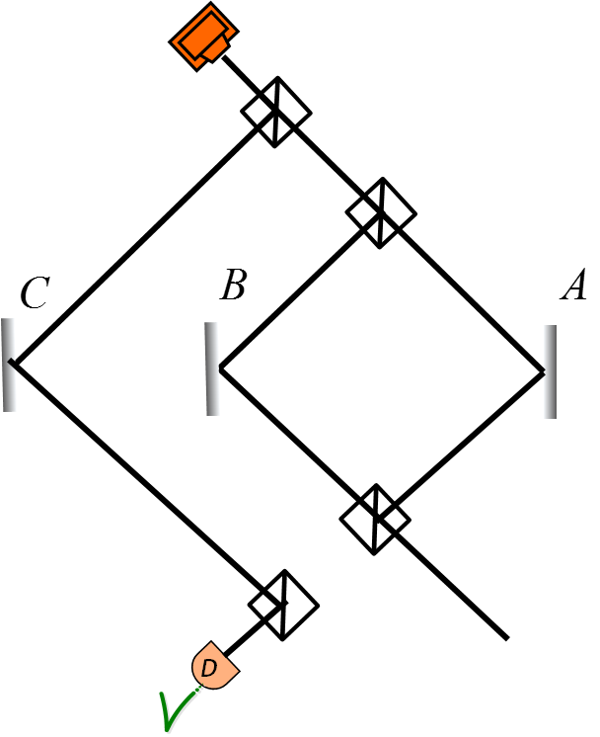
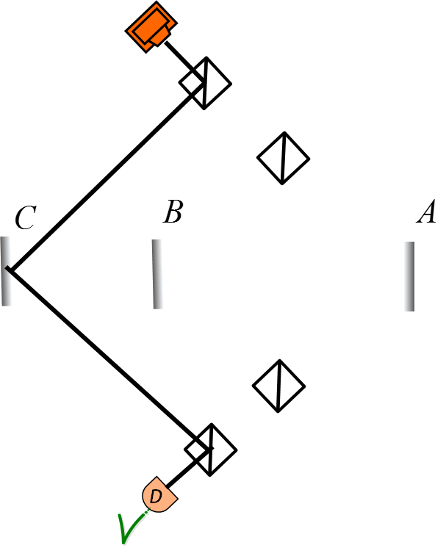
Where was a pre- and post-selected particle?

Slide 10
The two-state vector formalism of quantum mechanics
The pre- and post-selected particle is described by the two-state vector
Any coupling of a system described by to a variable O for a short enough time
is a coupling to a weak value
PRL 60, 1351 (1988)
PRA 96, 032114 (2017)

Slide 11
Where was a pre- and post-selected particle?

Slide 12
Where was a pre- and post-selected particle?

Slide 13
Where was a pre- and post-selected particle?
In the overlap of the forward and backward evolving wave functions

Slide 14
Where was a pre- and post-selected particle?
All interactions are local
All particles have nonzero local interactions
To be in A
= to leave a local trace in A
A
A
To be in A
Not to be in A

Slide 15
Was the particle in A or was not?
To be in A = to leave a local trace in A
A

Slide 16
Was the particle in A or was not?
A
A
Was in A
Was not in A

Slide 17
Was the particle in A or was not?
A
A
A
Was in A
Was not in A
Was in A with “presence”

Slide 18
What type of presence the particle had?
Weak value of the local projection operator
is the description of the presence of a quantum particle in a particular place in the past
tells us how the trace in A is modified
relative to the trace of a particle well localized in A
A
tells us how effects of all weak (or short) interactions in A are modified
relative to the effects of a particle well localized in A
Not to be in A
To be well localized in A
To be with “presence”

Slide 19
Experiment:
observing local trace in A
Dziewior, Knips, Farfurnik, Senkalla, Benshalom, Efroni, Meinecke, Bar-Ad, Weinfurter, Vaidman, PNAS, 116 288 (2019)
A

Slide 20
Experiment:
observing local trace in A
Dziewior, Knips, Farfurnik, Senkalla, Benshalom, Efroni, Meinecke, Bar-Ad, Weinfurter, Vaidman, PNAS, 116 288 (2019)
The particle is the measuring device
A
analyzer

Slide 21
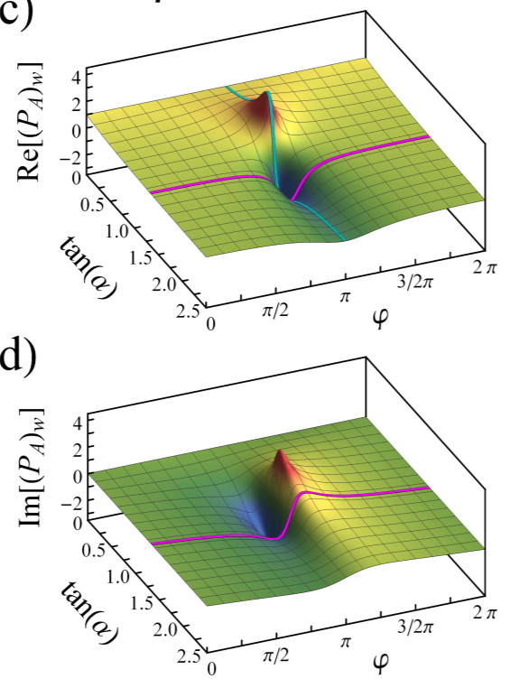
Experiment:
observing local trace in A
Dziewior, Knips, Farfurnik, Senkalla, Benshalom, Efroni, Meinecke, Bar-Ad, Weinfurter, Vaidman, PNAS, 116 288 (2019)
The particle is the measuring device
B
A
analyzer
D
To be well localized in A
To be with “presence”

Slide 22
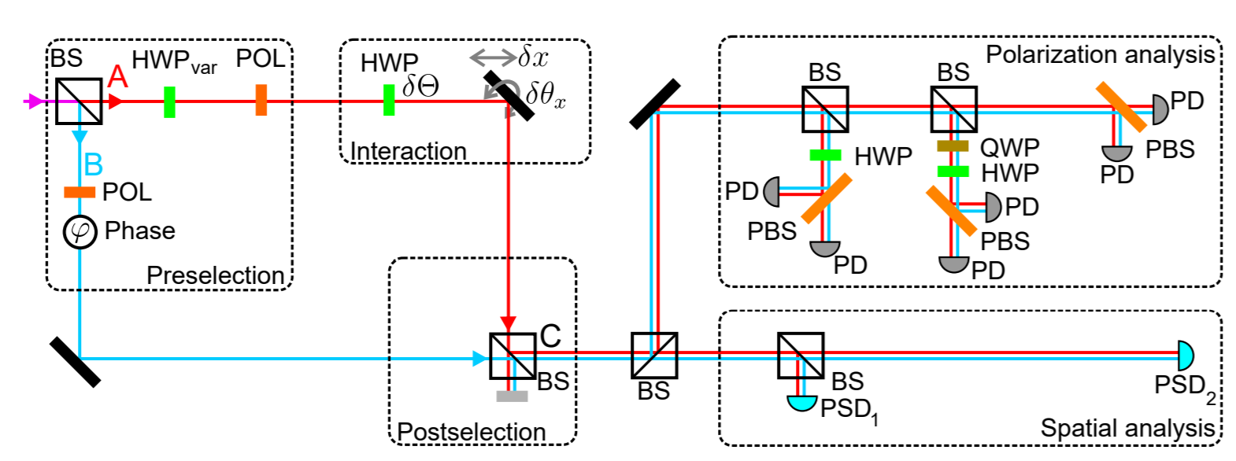
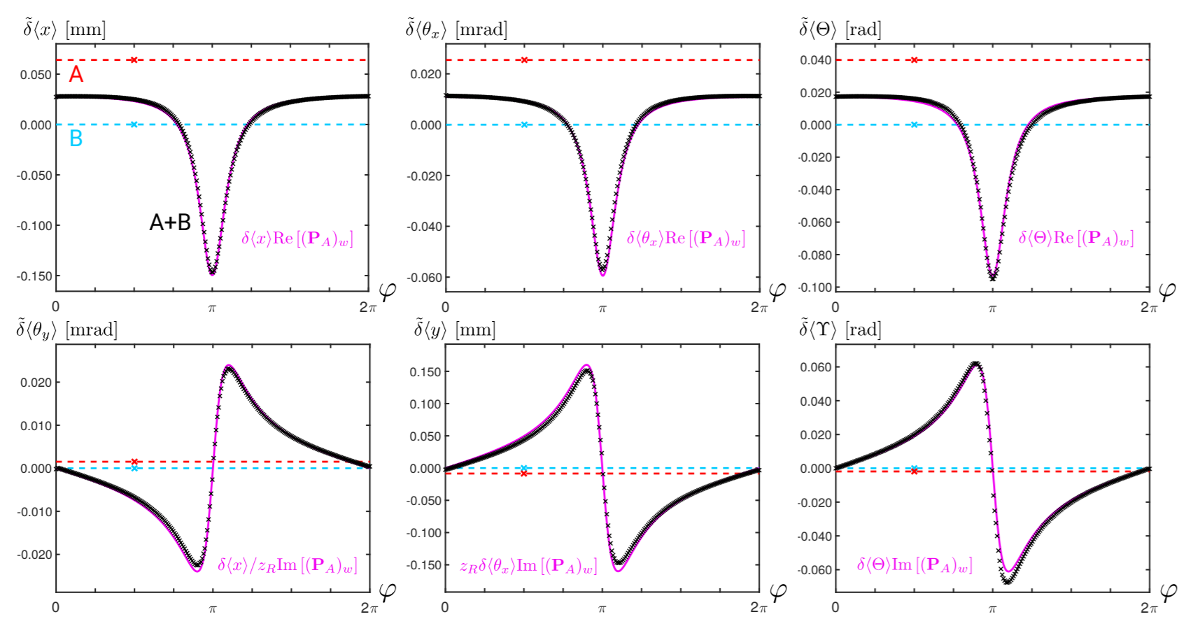
Experiment:
observing local trace in A
Dziewior, Knips, Farfurnik, Senkalla, Benshalom, Efroni, Meinecke, Bar-Ad, Weinfurter, Vaidman, PNAS, 116 288 (2019)
analyzer
analyzer

Slide 23
Summary
A pre and postselected particle:
Where it was?
Where it left a local trace
In the overlap of forward and backward evolving states
What type of presence it had?
describes the presence in A for a spatially pre- and postselected systems
All weak interactions in A are modified in the same way:
The effects are multiplied by (and change direction if )
The conjugate variables are affected in proportion to .

Slide 24
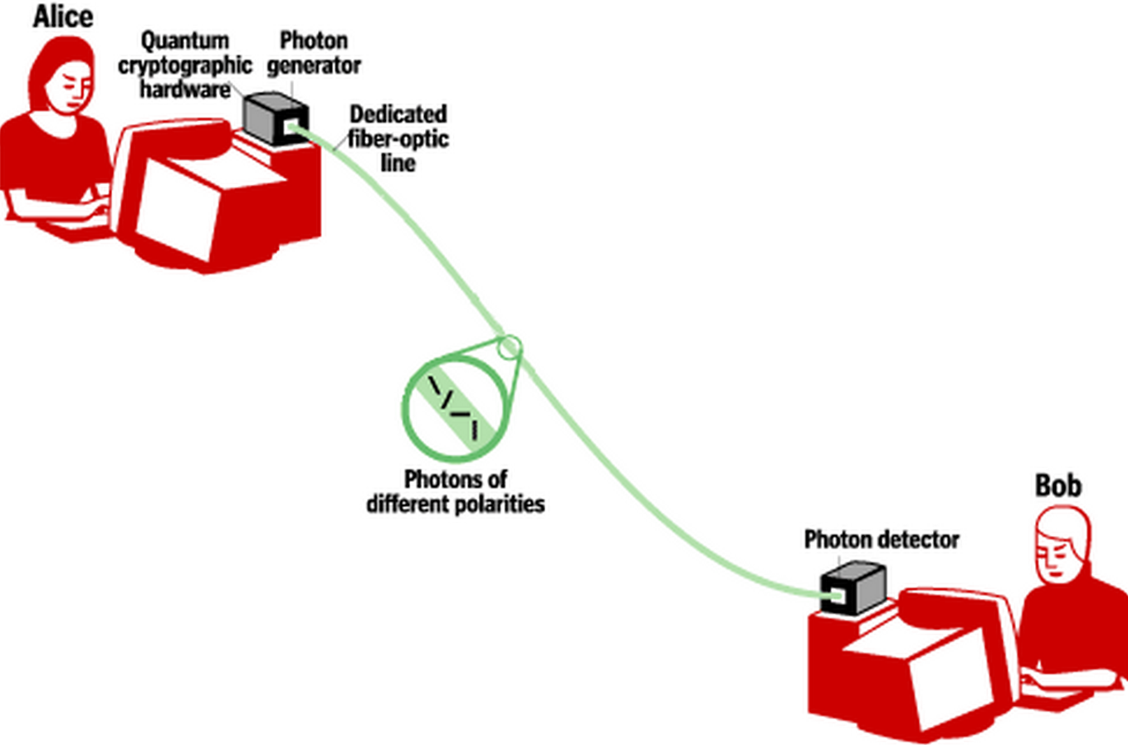

QUANTUM COMMUNICATION
COMMUNICATION USING QUANTUM STATES OF TRANSMITTED PARTICLES
COUNTERFACTUAL COMMUNICATION
COMMUNICATION WITHOUT PARTICLES IN THE TRANSMITION CHANNEL

Slide 25


Interaction-free measurement of a presence of an object
Elitzur and Vaidman, Found. Phys. 23, 987 (1993)
Counterfactual transmission of bit 1
We know that the object is in O but the photon was not in O

Slide 26
Interaction-free measurement of an absence of an object
Counterfactual transmission of bit 0
We know that the object is not in O and also there was no photon in O

Slide 27
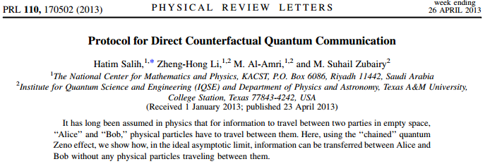
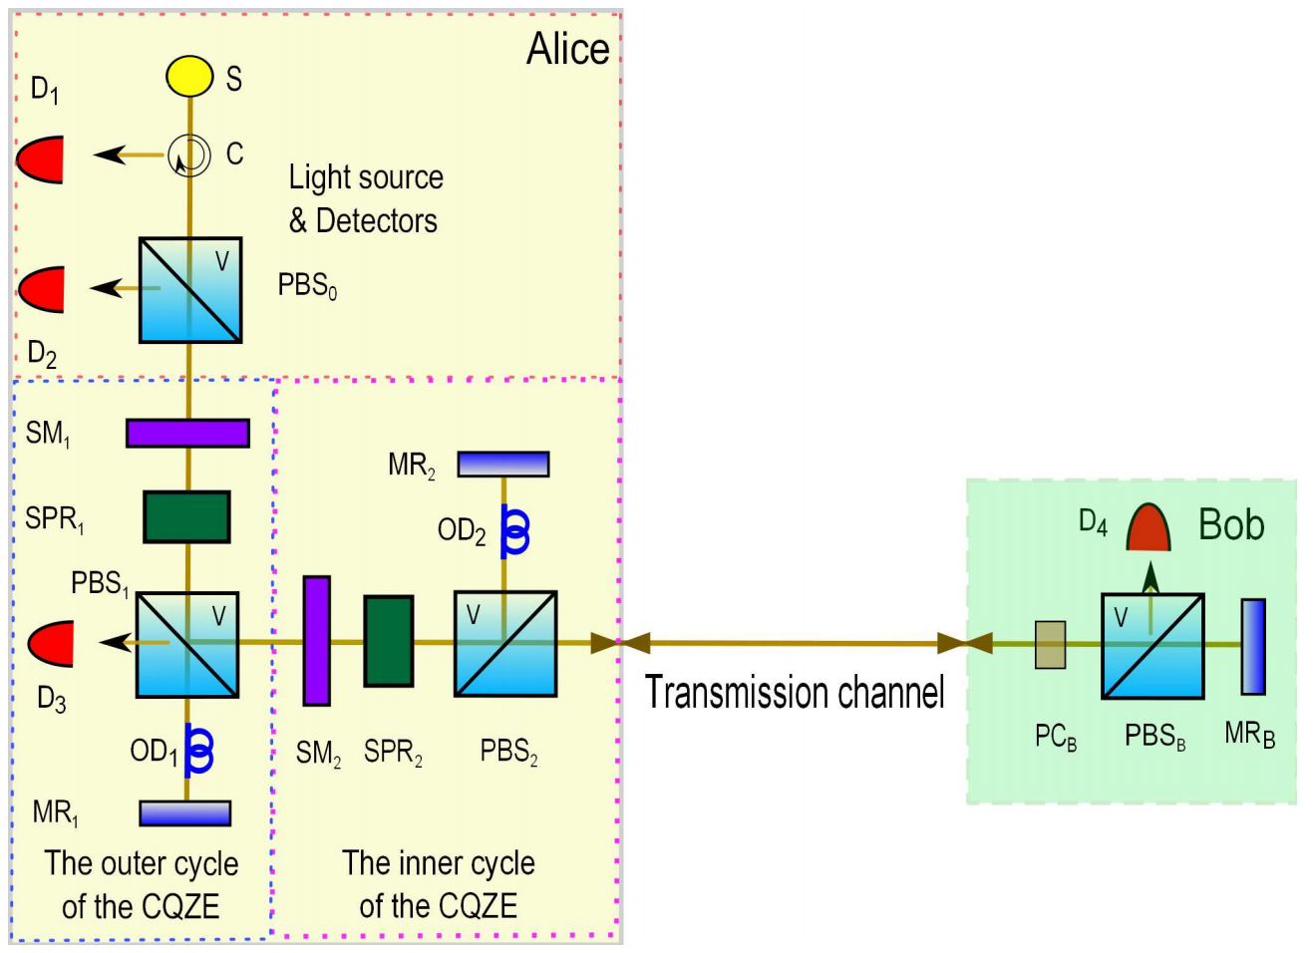
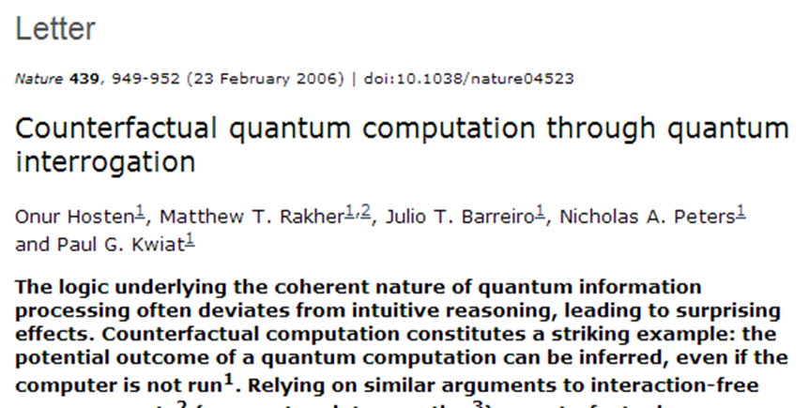
Counterfactual communication

Slide 28
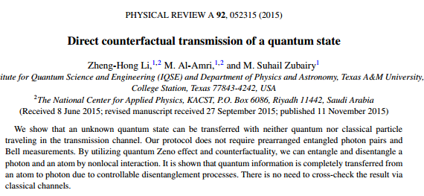
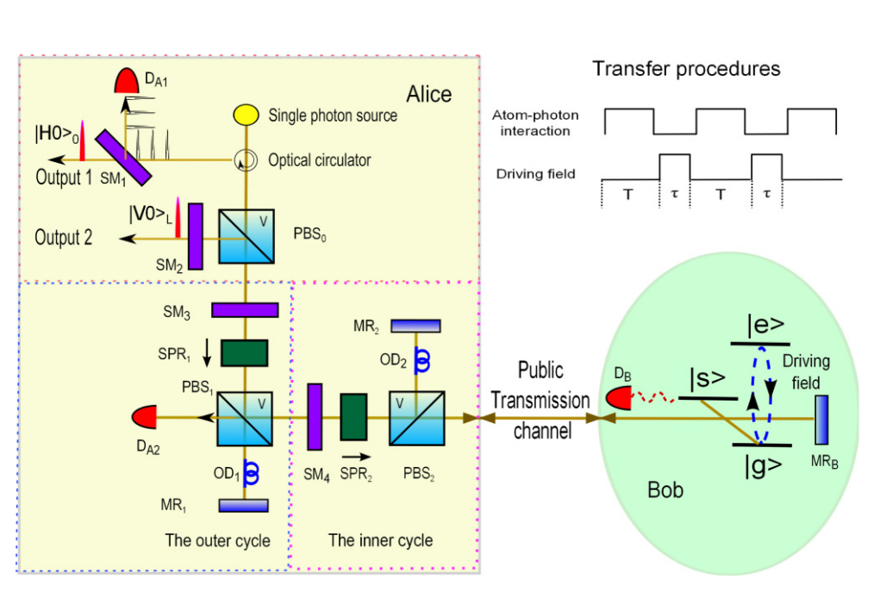
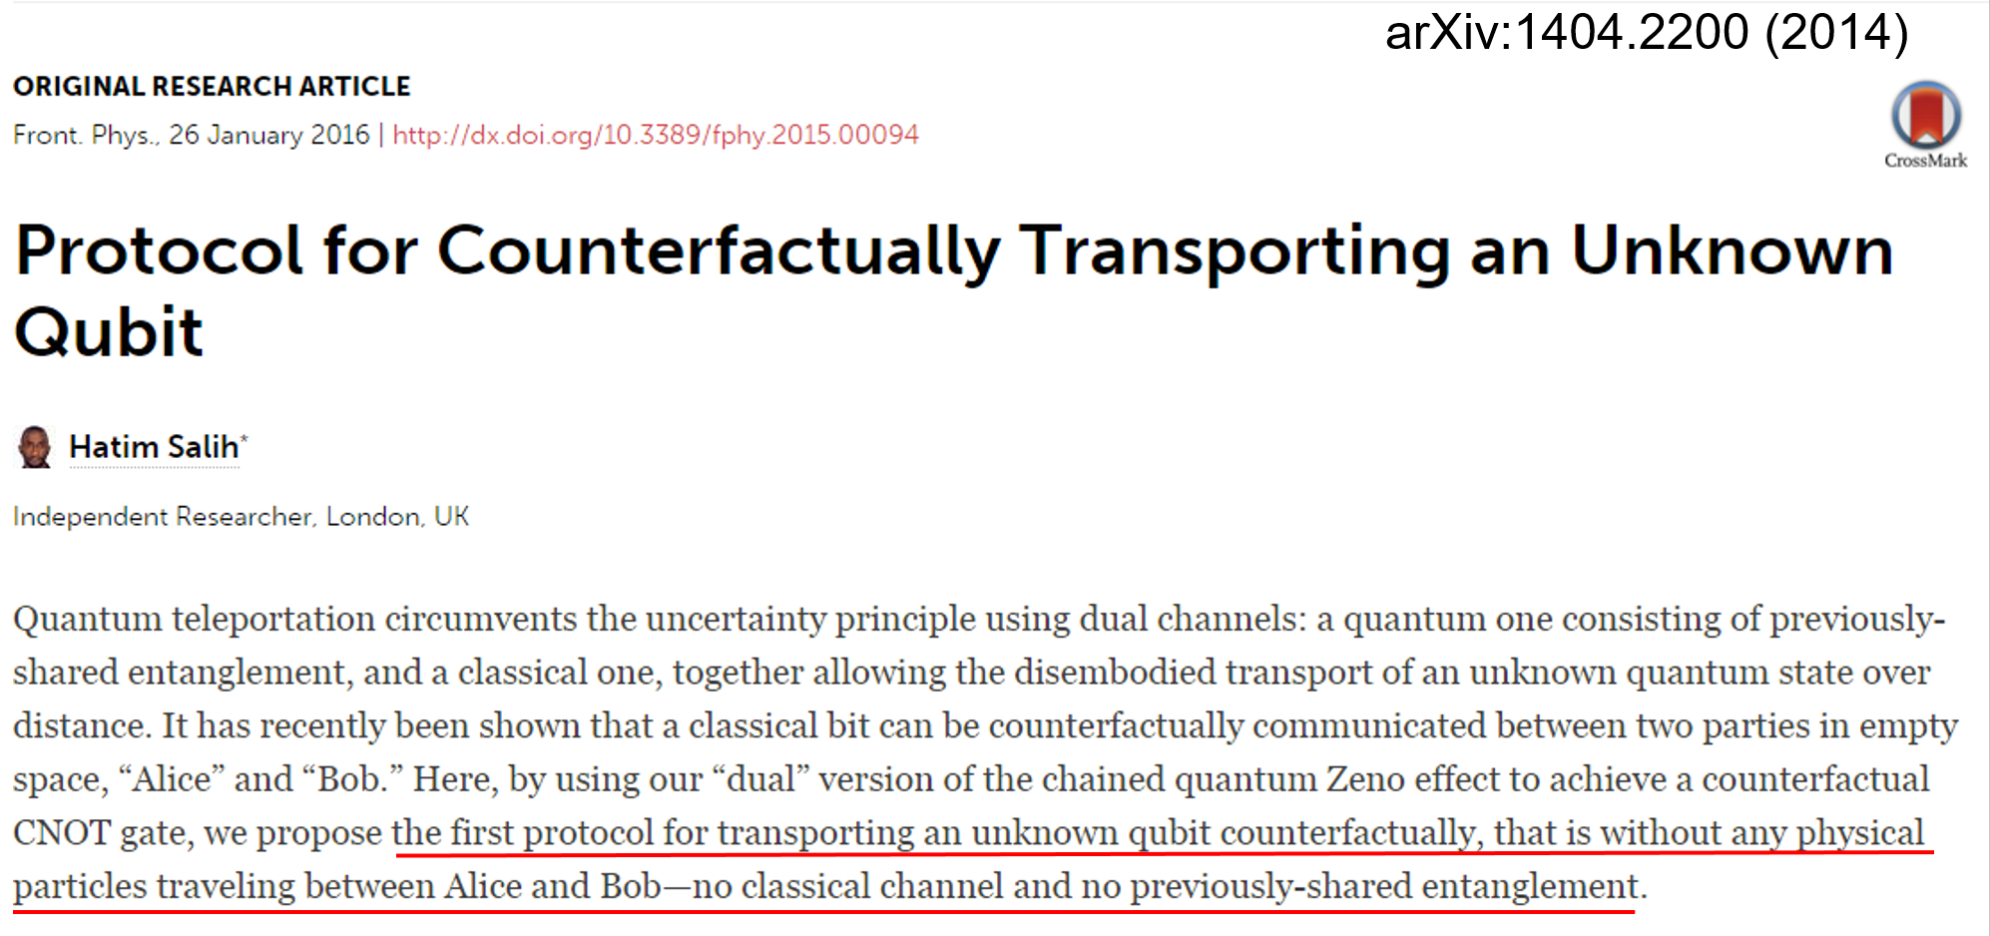
Counterfactual transmission of a quantum state
Counterfactual transmission of a quantum state: a new teleportation?

Slide 29
Conclusions 1
We can transfer a message or even a quantum state without particles being present in the transmission channel!

Slide 30
Interaction-free measurement of an absence of an object
Counterfactual transmission of bit 0
Is it really counterfactual?
Where was the photon?

Slide 31
Where was a pre- and post-selected particle?

Slide 32
Where was a pre- and post-selected particle?

Slide 33
Where was a pre- and post-selected particle?

Slide 34
The two-state vector formalism of quantum mechanics
The pre- and post-selected particle is described by the two-state vector
Weak trace appears in the overlap of the forward and backward evolving wave function

Slide 35
Where was a pre- and post-selected particle?
In the overlap of the forward and backward evolving wave functions

Slide 36
Where was a pre- and post-selected particle?
In the overlap of the forward and backward evolving wave functions

Slide 37
Where was a pre- and post-selected particle?
In the overlap of the forward and backward evolving wave functions

Slide 38
Interaction-free measurement of an absence of an object
Counterfactual transmission of bit 0
Not counterfactual!
Both forward and backward evolving wave functions are present in O
The photons left a trace in O
The photons could be found in O

Slide 39
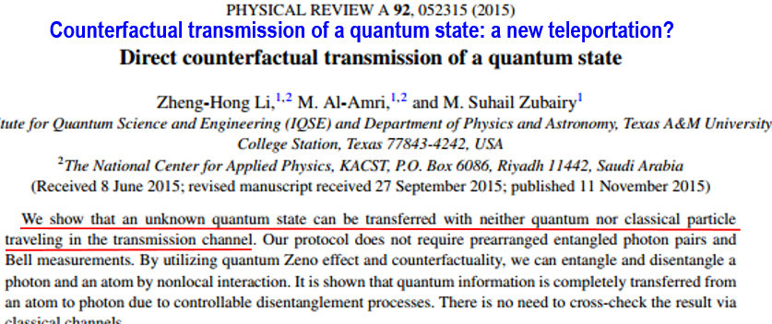
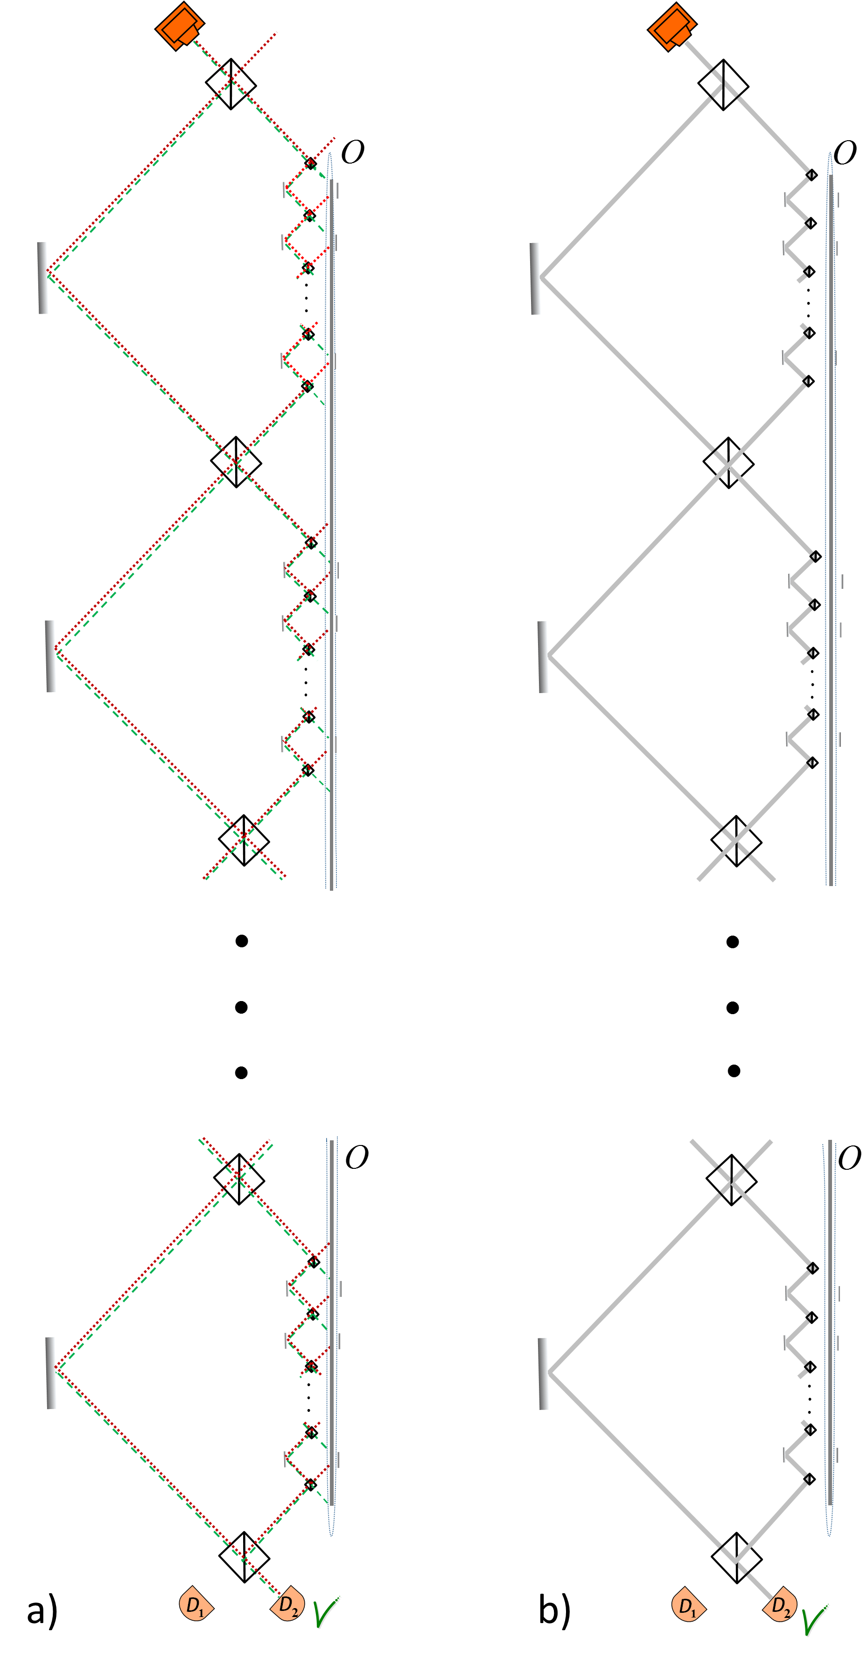
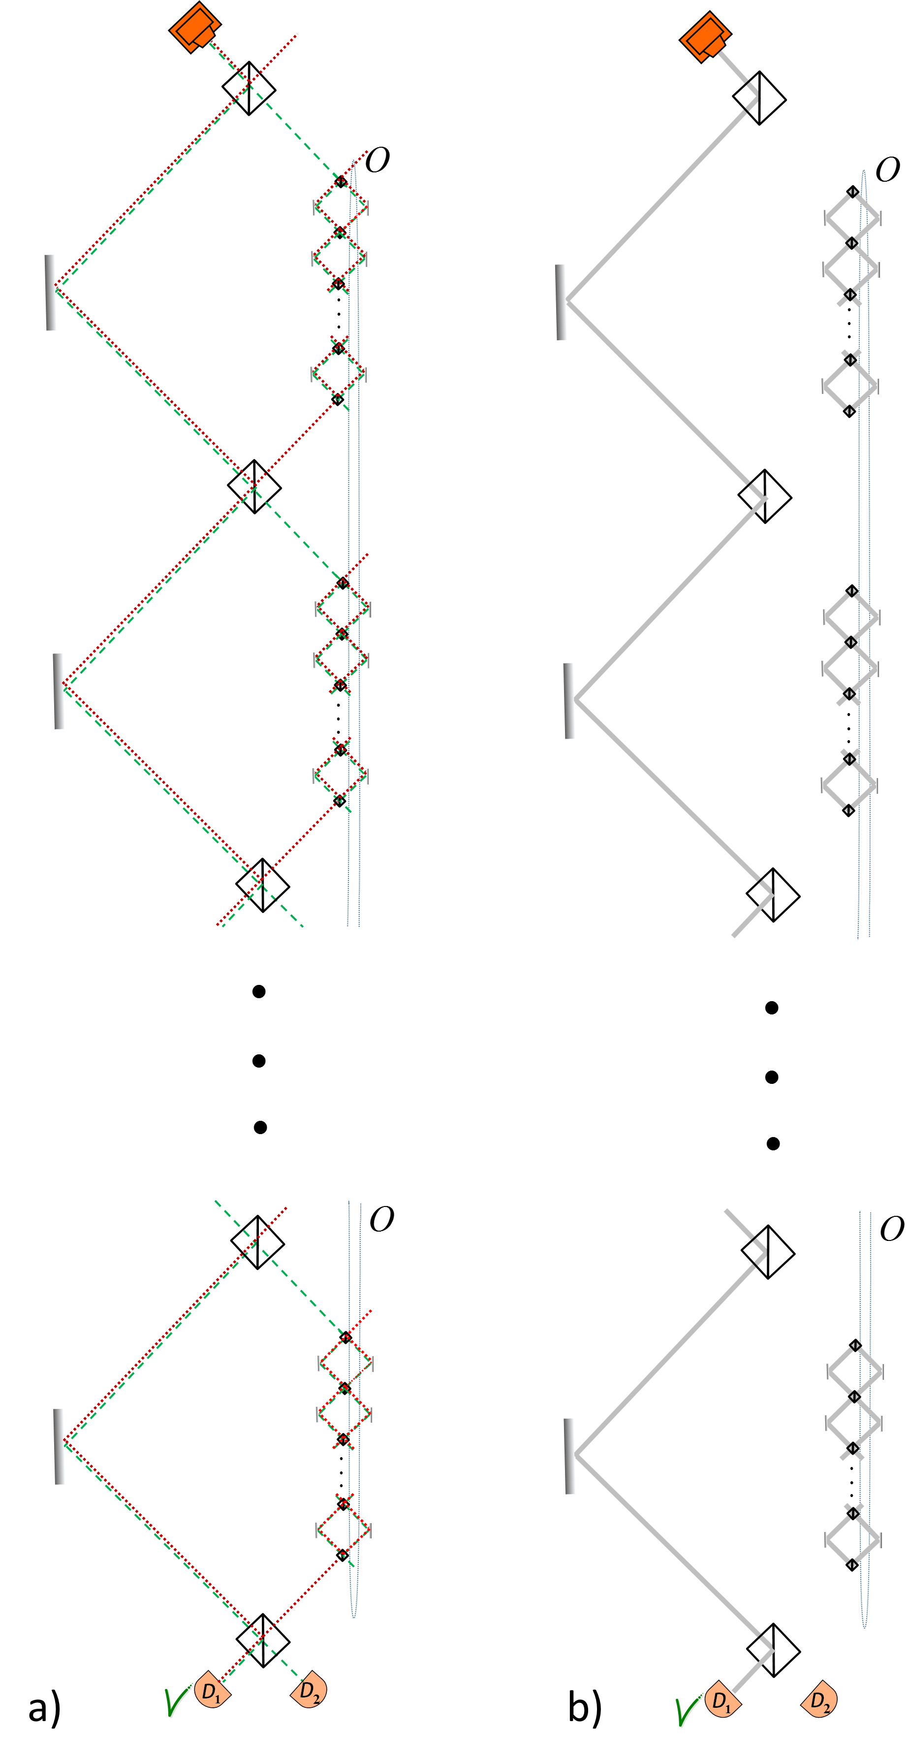
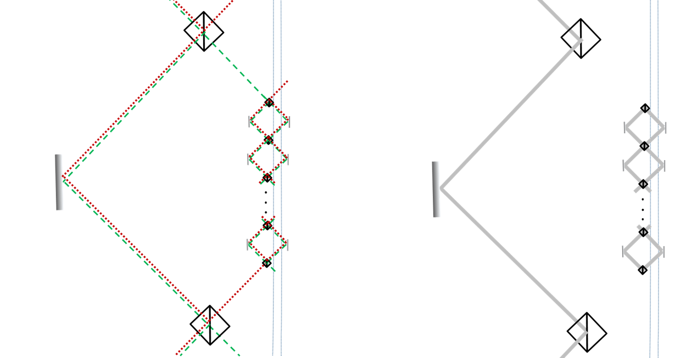
Not counterfactual!
Both forward and backward evolving wave functions are present in the transmission channel
The photons left a trace in the transmission channel
The photons could be found in the transmission channel

Slide 40
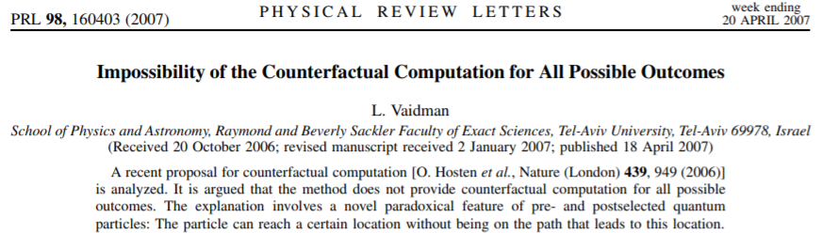

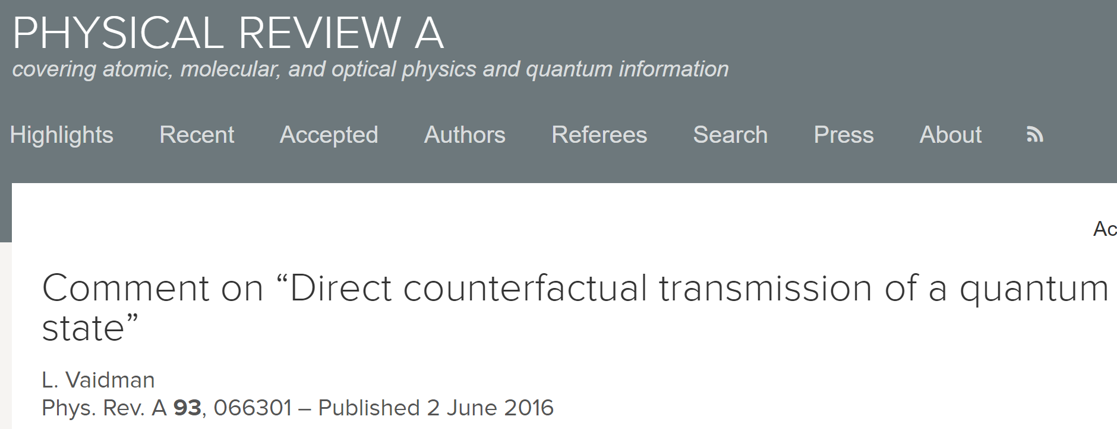
Not counterfactual!

Slide 41
Conclusions 2
We cannot transfer a message or a quantum state without particles being present in the transmission channel, i.e. without leaving any trace there!

Slide 42
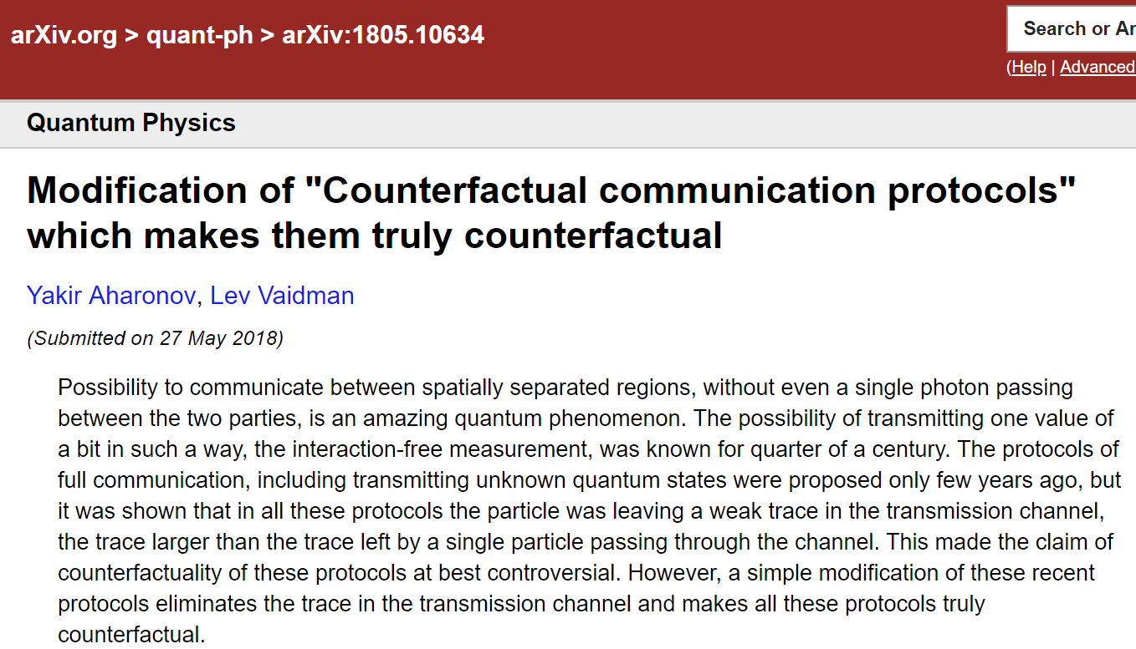
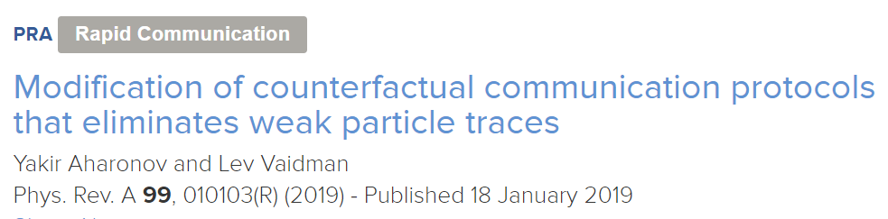
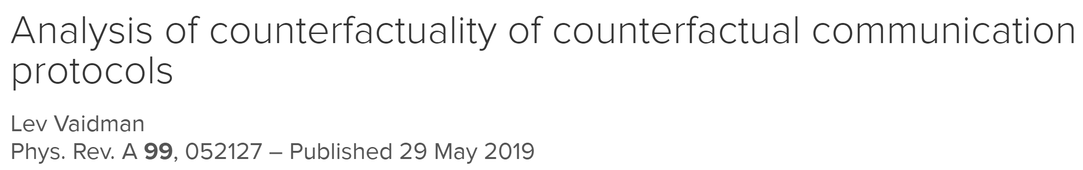

Slide 43
Interaction-free measurement of an absence of an object
Counterfactual transmission of bit 0
Not counterfactual!
Both forward and backward evolving wave functions are present in O
The photons left a trace in O
The photons could be found in O

Slide 44
Modified Interaction-free measurement of the absence of an object
The photons could not be found in O or O’

Slide 45
Modified Interaction-free measurement of the absence of an object
Counterfactual!
There is no overlap of the forward and backward evolving wave functions in O and O’
The photons left no trace in O and O’

Slide 46
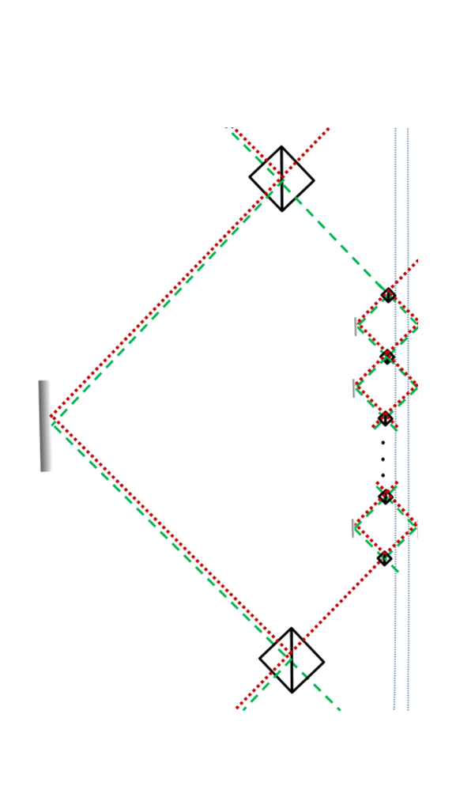
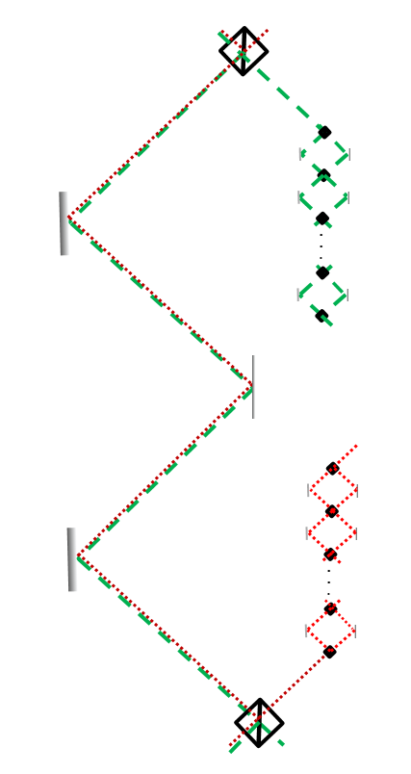
Counterfactual!
The photons left no trace and could not be found in the transmission channel

Slide 47
Conclusions 3
We can transfer a message or even a quantum state without particles being present in the transmission channel, i.e. without leaving any trace there!

Slide 48
Conclusions 3
We can transfer a message or even a quantum state without particles being present in the transmission channel, i.e. without leaving any (?!) trace there.

Slide 49
Modified Interaction-free measurement of the absence of an object
The photons could not be found in O or O’
if searched in one of the places

Slide 50
Modified Interaction-free measurement of the absence of an object
The photons could be found in O or O’
if searched in both places

Slide 51
Modified Interaction-free measurement of the absence of an object
Counterfactual!
first order
There is no overlap of the forward and backward evolving wave functions in O and O’
The photons left no trace in O and O’

Slide 52
Conclusions 4
We can transfer a message or even a quantum state without particles being present in the transmission channel, i.e. without leaving first order trace there!

