Slide 1


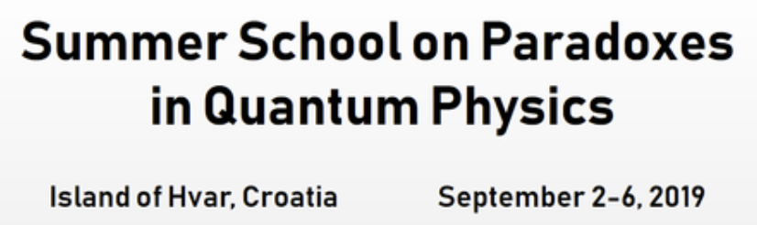
Five paradoxes on the theme of the Aharonov-Bohm effect
Lev Vaidman

Slide 2
Classical physics failed to provide an explanation for
Mach Zehnder Interferometer with particles

Slide 3
Mach Zehnder Interferometer

Slide 4
Mach Zehnder Interferometer
Quantum physics provides a good explanation:
Local interaction and interference

Slide 5
Mach Zehnder Interferometer
Quantum physics provides a good explanation:
Local interaction and interference
Classical lag of the wave packet causes a change in the phase

Slide 6
Mach Zehnder Interferometer

Slide 7
Aharonov-Bohm Effect

Slide 8
Aharonov-Bohm Effect

Slide 9
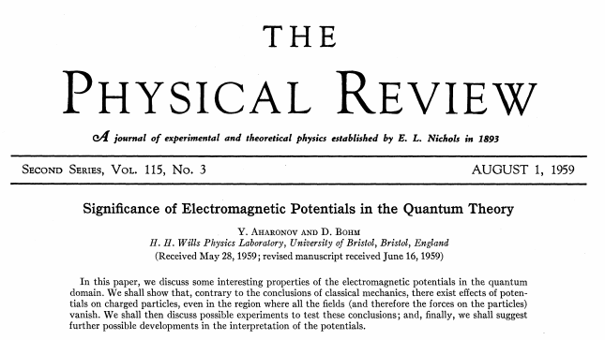
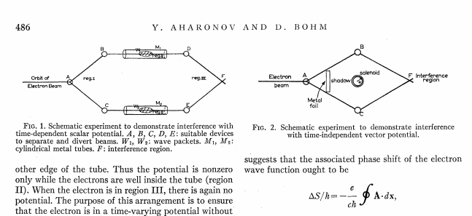

Slide 10
Aharonov-Bohm Effect
The solenoid causes a relative phase, but the time when the phase is gained depends on the choice of gauge, and therefore, it is unobservable.

Slide 11
Aharonov-Bohm Effect
The solenoid causes a relative phase, but the time when the phase is gained depends on the choice of gauge, and therefore, it is unobservable.

Slide 12
Aharonov-Bohm Effect
The solenoid causes a relative phase, but the time when the phase is gained depends on the choice of gauge, and therefore, it is unobservable.

Slide 13
Aharonov-Bohm Effect
The solenoid causes a relative phase, but the time when the phase is gained depends on the choice of gauge, and therefore, it is unobservable.

Slide 14
Aharonov-Bohm Effect
The solenoid causes a relative phase, but the time when the phase is gained depends on the choice of gauge, and therefore, it is unobservable.

Slide 15
Paradox I
At every place on the paths of the wave packets of the electron there is no observable action, but nevertheless, the relative phase is obtained.

Slide 16
Paradox II
The relative phase is observable locally, therefore the time of change of the relative phase can be observed, in contradiction with the fact that it is a gauge dependent property.

Slide 17
The relative phase of a photon is observable locally

Slide 18
The relative phase of a photon is observable locally
L. Hardy, Phys. Rev. Lett. (1994)

Slide 19
The relative phase of a charged pion is observable locally
Y. Aharonov, and L. Susskind, Phys. Rev. 155, 1428 (1967)
This is a gedanken experiment because such a coherent state is unstable

Slide 20
Paradox II
The relative phase is observable locally, therefore the time of change of the relative phase can be observed in contradiction with the fact that it is gauge dependent property.

Slide 21
The key to the resolution of the paradox is that a measuring device measuring relative the phase “feels” the Aharonov-Bohm effect too.

Slide 22
Paradox II - resolution
The relative phase of the measuring device which measures the relative phase of the particle also depends on the chosen gauge. In fact, local outcomes are not influenced by the solenoid, only their interpretation is. Even the interpretation is gauge dependent.

Slide 23
Paradox II - resolution
The relative phase of the measuring device which measures the relative phase of the particle also depends on the chosen gauge. In fact, local outcomes are not influenced by the solenoid, only their interpretation is. Even the interpretation is gauge dependent.

Slide 24
Paradox II - resolution
The relative phase of the measuring device which measures the relative phase of the particle also depends on the chosen gauge. In fact, local outcomes are not influenced by the solenoid, only their interpretation is. Even the interpretation is gauge dependent.

Slide 25
Paradox I
At every place on the paths of the wave packets of the electron there is no observable action, but nevertheless, the relative phase is obtained.

Slide 26
The Aharonov-Casher Effect is dual to the Aharonov-Bohm Effect
due to symmetry in electron neutron interaction
Aharonov-Bohm Effect
Aharonov-Casher Effect
ELECTRON
NEUTRON
SOLENOID
LINE OF CHARGE
The motion of the electron should be identical to the motion of the neutron,
but the neutron feels force!?

Slide 27
Paradox III
The motion of the electron inside the interferometer is the same with or without the solenoid
ELECTRON
ELECTRON
AC dual to AB
NEUTRON
NEUTRON
LINE OF CHARGE
The motion of the electron is identical to the motion of the neutron

Slide 28
NEUTRON
LINE OF CHARGE
Neutron slows down
F
F
x
x
F
F
x
x
Neutron accelerates
Notes:
Another topological effect: Aharonov-Casher Effect

Slide 29
The force exerted on the neutron
T.H. Boyer, Am .J. Phys. 56, 688 (1988)
The model of the magnetic moment μ of a neutron
μ
N
A neutron is not two magnetic monopoles
S
I
It is a current loop

Slide 30
The force exerted on the neutron
T.H. Boyer, Am .J. Phys. 56, 688 (1988)
A moving current loop has an electric dipole moment
F
x
The inhomogeneous electric field exerts force on the dipole
d
E

Slide 31
Paradox IV (Aharonov)
The forces exerted on the neutron can give energy for nothing!
F
F
x
x
F
F
x
x
Notes:
Another topological effect: Aharonov-Casher Effect

Slide 32
Paradox IV (Aharonov)
The forces exerted on the neutron can give energy for nothing!

Slide 33
Paradox IV (Aharonov)
The forces exerted on the neutron can give energy for nothing!
F
x
V

Slide 34
Paradox IV (Aharonov)
The forces exerted on the neutron can give energy for nothing!
F
x
V
d
d

Slide 35
Paradox IV (Aharonov)
The forces exerted on the neutron can give energy for nothing!
F
x
d
d

Slide 36
Paradox IV (Aharonov)
The forces exerted on the neutron can give energy for nothing!
F
x
d
d

Slide 37
Paradox IV (Aharonov)
The forces exerted on the neutron can give energy for nothing!
F
x
d
d

Slide 38
Paradox IV (Aharonov)
The forces exerted on the neutron can give energy for nothing!
F
x
d
d

Slide 39
Paradox IV (Aharonov)
The forces exerted on the neutron can give energy for nothing!
d
d

Slide 40
Paradox V
W. Shockley and R.P. James, PRL 171, 1370 (1967)
A cannon with no recoil

Slide 41
Paradox V
W. Shockley and R.P. James, PRL 171, 1370 (1967)
A cannon with no recoil
An isolated system consists of a current loop (two oppositely rotating and oppositely charged disks) and a charge which are originally at rest.
When the current dies out, the charge starts moving, while the disks apparently stay in place.

Slide 42
Resolution of Paradoxes V, IV,III
(Re)discovery of “hidden momentum”
Y. Aharonov, P. Pearle, and L. Vaidman, PRA 38, 1863 (1988)
A current loop in a static electric field has a nonzero linear momentum
Resolution of Paradox V (recoil-free cannon)
When the current stops, the hidden momentum of the current loop is transferred to the mechanical momentum of the tube. The loop recoils to the left.

Slide 43
Resolution of Paradoxes V, IV,III
(Re)discovery of “hidden momentum”
Y. Aharonov, P. Pearle, and L. Vaidman, PRA 38, 1863 (1988)
A current loop in a static electric field has a nonzero linear momentum
Resolution of Paradox V (recoil-free cannon)
When the current stops, the hidden momentum of the current loop is transferred to the mechanical momentum of the tube. The loop recoils to the left.
There is no recoil-free cannon.

Slide 44
How comes hidden momentum?
A current loop in a static electric field has a nonzero linear momentum
Hint: paradox VI
Paradox of Two Lorentz Observers

Slide 45
Paradox VI
Charged particle, charged plate, and two Lorentz Observers
Alice’s view

Slide 46
Paradox VI
Charged particle, charged plate, and two Lorentz Observers
Bob’s view

Slide 47
Hidden momentum
The current loop model: free charges moving inside a frictionless tube
V
i
(This and other models: L. Vaidman, AJP 58, 978 (1990))
q
p
i
hid
E

Slide 48
Resolution of Paradox IV
but
exactly

Slide 49
Resolution of Paradox III
The motion of the electron inside the interferometer is the same with or without the solenoid
ELECTRON
ELECTRON
AC dual to AB
NEUTRON
NEUTRON
LINE OF CHARGE
The motion of the neutron inside the interferometer is the same with or without the line of charge.
The motion of the electron is identical to the motion of the neutron

Slide 50
Paradox I
At every place on the paths of the wave packets of the particle there is no observable action, but nevertheless, the relative phase is obtained.
Aharonov-Bohm Effect
Aharonov-Casher Effect
ELECTRON
NEUTRON
SOLENOID
LINE OF CHARGE
Conclusion
Paradox I is an unavoidable property of both Aharonov Bohm and Aharonov Casher effects which makes them nonlocal topological effects

Slide 51
Paradox I
The solenoid causes a relative phase without classical lag.

Slide 52
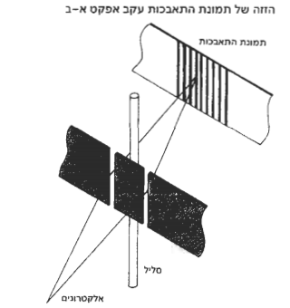
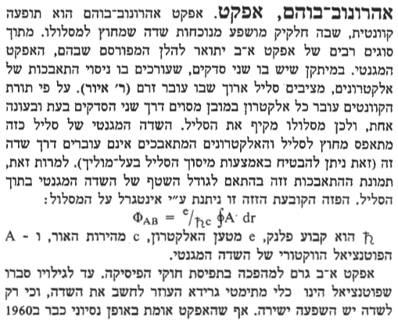
The Aharonov–Bohm effect validates the view that forces are an incomplete way to formulate physics,…
Wikipediea
Until the discovery of the AB phase it was believed that the phase is just an auxiliary concept for calculating fields which have direct physical effects.
Hebrew Encyclopedia Lev Vaidman

Slide 53
Paradox I
The solenoid causes a relative phase without classical lag.
The solenoid causes a relative phase through obtaining its own classical lag due to the local action of the field of the electron.

Slide 54
A good explanation
Aharonov-Bohm effect does have local explanation if everything, including the source of the magnetic flux is treated quantum mechanically.
Role of Potentials in the Aharonov-Bohm Effect
L. Vaidman,
Phys. Rev. A R86, 040101 (2012) 1110.6169
The AB phase is acquired by the solenoid due to local action of electromagnetic field of the electron

Slide 55
Model of the magnetic Aharonov-Bohm Effect

Slide 56
Model of the magnetic Aharonov-Bohm Effect
Entanglement (if it was) disappears.

Slide 57
I want to believe:
Physical interactions are only through local fields
Potentials are just a useful auxiliary mathematical tool
But:
There is no formulation of QM with local fields.
What is the counterpart of in QM?
I do not have a theory, but I have a hint that it exists
no interaction
Special case of the Electric AB Effect

Slide 58
Electric Aharonov-Bohm Effect

Slide 59
Special case Electric Aharonov-Bohm Effect
No Effect!
The charges move only when the electron comes

Slide 60
Special case of Electric Aharonov-Bohm Effect
Field explanation of no effect
The charges move only when the electron comes

Slide 61
Special case Electric Aharonov-Bohm Effect
Field explanation of no effect
Field is zero at location of every particle, therefore there is no any effect
The charges move only when the electron comes

Slide 62
Summary and conclusion
The standard approach to the AB effect leads to a paradoxical nonlocal feature of quantum mechanics: the AB phase is acquired inside the interferometer in spite of the fact that there is no particular place or time where this happens.
The paradox disappears when all relevant parts of the system are considered: the phase is gradually acquired by the source of the electromagnetic potential.
The interference observed by the electron is due to the phase acquired locally by the source being in the field of the electron.
The core of the effect is that quantum wave function is for all systems together, but surprisingly, the effect can take place almost without entanglement between the source and the electron.
The evolution of charged particles in the original AB experiments can be described completely by fields at locations of all particles.
The road to quantum theory without potentials is open.

