Slide 1



The paradox of the two observers
Lev Vaidman

Slide 2
PARADOX OF TWO OBSERVERS
Alice stands on a charged surface
, Bob moves on this surface with constant velocity
Alice throw a charged particle
and calculates the trajectory Bob should see
Bob sees Alice throwing the particle and calculates the trajectory he should see
Their calculations lead to different answers
PARADOX!

Slide 3
Alice’s point of view

Slide 4
Bob’s point of view

Slide 5
Alice’s point of view
Infinite homogeneously charged surface

Slide 6
Alice’s point of view
Infinite homogeneously charged surface
חלקיק בעל מטען מסה ומהירות התחלתית

Slide 7
Alice’s point of view
(side view)

Slide 8
Alice’s point of view
(side view)
THE TRAJECOTRY IS A STRAIGHT LINE

Slide 9
Bob’s point of view

Slide 10
Bob’s point of view

Slide 11
Bob’s point of view
Infinite homogeneously charged surface moving with constant velocity

Slide 12
Bob’s point of view
Infinite homogeneously charged surface moving with constant velocity

Slide 13
Bob’s point of view
Infinite homogeneously charged surface moving with constant velocity

Slide 14
WHO IS RIGHT?
Bob sees a straight line
Bob sees a curved line

Slide 15
Alice’s point of view
(side view)
Alice: Bob sees straight line

Slide 16
Bob’s point of view
(side view)
Bob: I see a curved line

Slide 17
PARADOX OF TWO OBSERVERS
Alice: Bob sees a straight line
WHO IS RIGHT?
Bob: I see a curved line

Slide 18

In favor of the Many Worlds Interpretation

Slide 19
The goal: Explaining our World
The thesis: the MWI is a good a explanation
The argument:
Quantum textbook explanation is good except for the collapse, an unacceptable physical process
The MWI replaces physical collapse by acceptable human science ``world splitting’’
Outline
Interaction-free measurement paradox
Actual splitting of the world
Testing the MWI
Quantum textbook explanation
3D experience described by the wave function in 3ND
The issue of probability in the MWI
Summary

Slide 20
THE PARADOX OF
THE INTERACTION-FREE MEASUREMENT
A. Elitzur and L. Vaidman
Found. Phys. 23, 987 (1993) .

Slide 21
BOMB:
explodes when any particle “touches” it
interacts only through explosion
HOW TO FIND BOMB WITHOUT EXPLODING IT?
QUANTUM MECHANICS SOLVES THIS [ PARADOX

Slide 22
Interaction-free measurement

Slide 23
Interaction-free measurement

Slide 24
Interaction-free measurement

Slide 25
Interaction-free measurement

Slide 26
Interaction-free measurement
We know the bomb is there
Nothing touched the bomb: PARADOX!

Slide 27


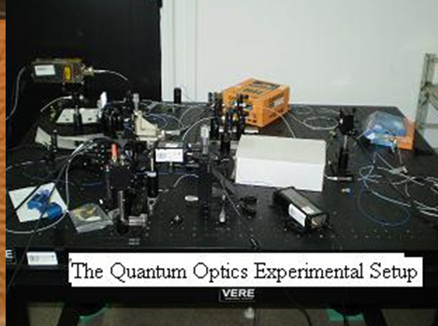
http://qol.tau.ac.il/TWS.html
The Quantum World Splitter
Choose how many worlds you want to split by pressing one of the red dice faces.

Slide 28
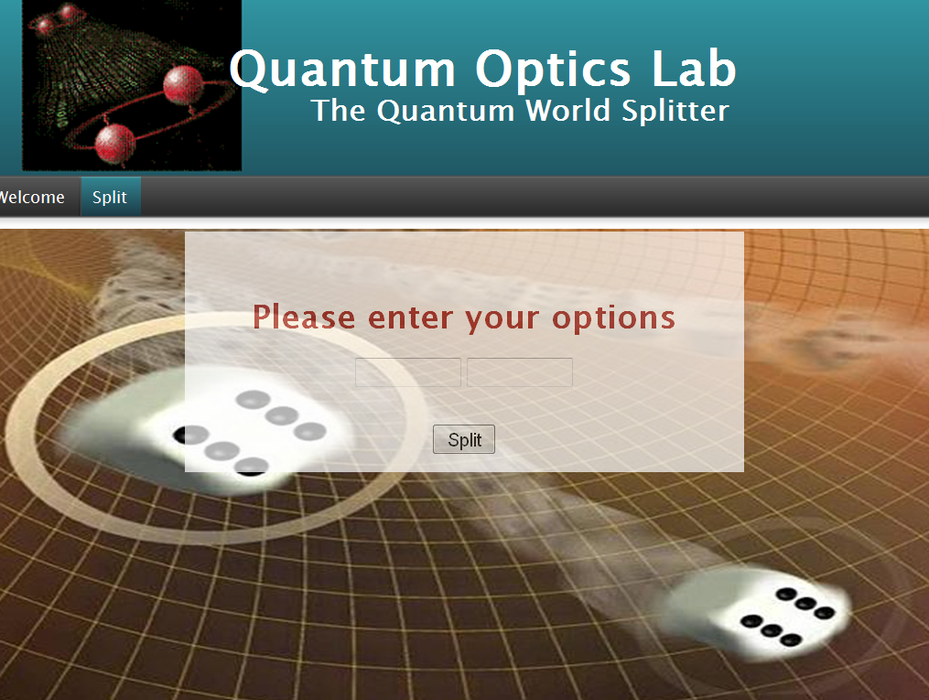
http://qol.tau.ac.il/TWS.html
left
right

Slide 29
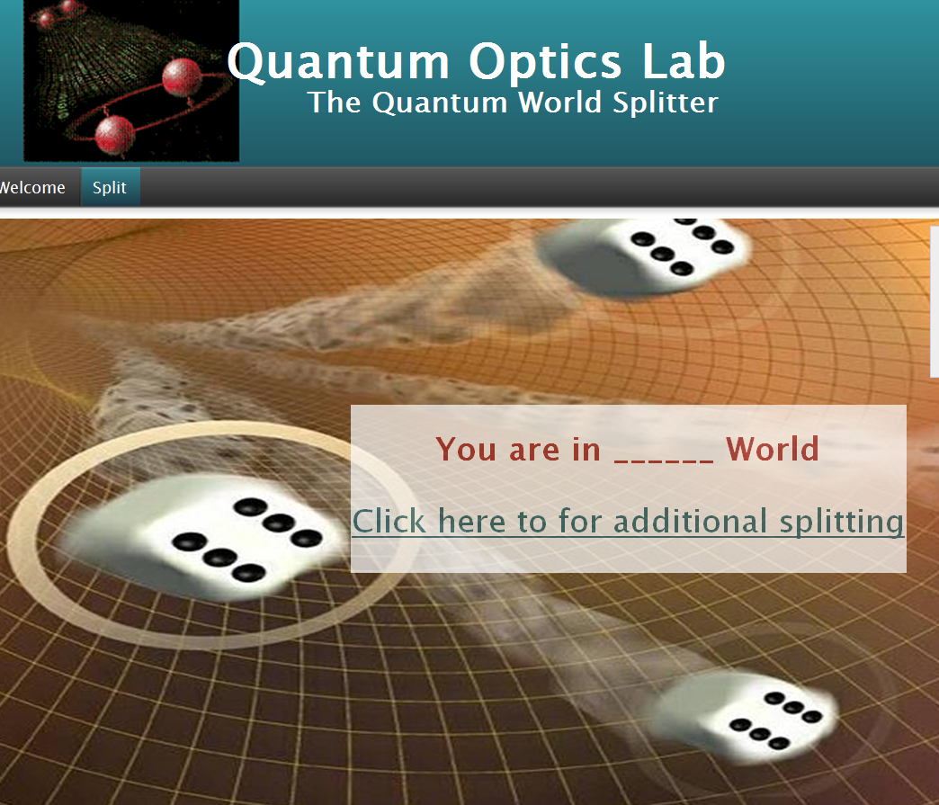
http://qol.tau.ac.il/TWS.html
right

Slide 30
World-splitter of Tel Aviv University

Slide 31
World-splitter of Tel Aviv University

Slide 32
Two worlds universe

Slide 33
Two worlds universe
One world does not disturb the other

Slide 34
Two worlds universe
One world does not disturb the other

Slide 35
Test of the MWI

Slide 36
Test of the MWI
No click!

Slide 37
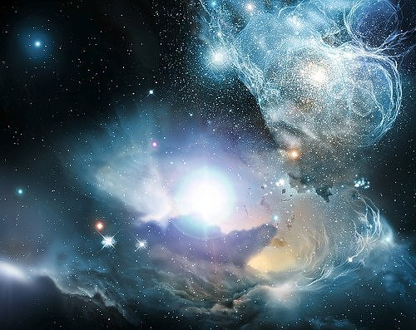
All is

Slide 38
Hope:
Today’s physics explains all what we see.
Big hope:
Today’s physics explains All.
If ψ is not All, what is?
The quantum mechanical formalism does not provide physicists with a ‘pictorial’ representation: the ψ-function does not, as Schrödinger had hoped, represent a new kind of reality.
Instead, as Born suggested, the square of the absolute value of the ψ-function expresses a probability amplitude for the outcome of a measurement.
Bohr (SEP):
Bohr and today’s majority of physicists gave up the hope.
I think, we should not.

Slide 39
All is
evolving according to relativistic generalization of the Schrodinger equation
NO COLLAPSE!
All is a single Universe
correponding to multiple worlds

Slide 40
A CENTURY AGO:
All is particles
evolving according to Newton’s equations
Laplacian determinism

Slide 41
Laplacian determinism
Observation
TRIVIAL
The Many Worlds Interpretation
HARD
Many parallel
Observations

Slide 42
What is “a world” in the many-worlds picture?
Many parallel
Observations
many
worlds
Observation i
world i
A world is the totality of (macroscopic) objects: stars, cities, people, grains of sand, etc. in a definite classically described state.
The MWI in SEP
is a Localized Wave Packet
for a period of time

Slide 43
All is
Textbook Quantum Mechanics:
Schrodinger equation
Collapses at measurements

Slide 44
All is
Textbook Quantum Mechanics:
Schrodinger equation
Collapses at measurements
Born Rule (peaceful coexistence with relativity)

Slide 45
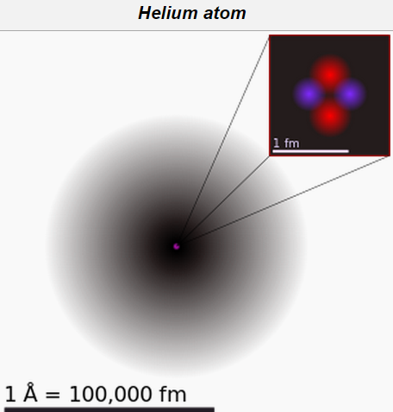
All is
Textbook Quantum Mechanics:
Schrodinger equation
Collapses at measurements
Born Rule (peaceful coexistence with relativity)
Postulate: experience supervene on
PROBLEM: we experience 3D
EXPERIENCE
is in 3N D
Quantum states of all macroscopic objects are Localized Wave Packets
EXPERIENCE
macroscopic objects
Entanglement is in 3N D
macroscopic objects are in 3D
but
EXPERIENCE
entanglement in atoms
is not relevant
atom
For macroscopic objects entanglement does not exists

Slide 46
All is
Textbook Quantum Mechanics:
Schrodinger equation
Collapses at measurements
Born Rule (peaceful coexistence with relativity)
COLLAPSE IS
A PROBLEM!
Postulate: experience supervene on
PROBLEM: we experience 3D
EXPERIENCE
is in 3N D
Quantum states of all macroscopic objects are Localized Wave Packets
EXPERIENCE
macroscopic objects
Entanglement is in 3N D
macroscopic objects are in 3D
but
EXPERIENCE
entanglement in atoms
is not relevant
To live is to interact
WE live in 3D!
atom
For macroscopic objects entanglement does not exists

Slide 47
COLLAPSE IS BAD!
The reduction [collapse] postulate is an ugly scar on what would be a beautiful theory if it could be removed
Gottfried (1989)
Not well defined
Pearle-GRW, Diosi-Penrose
… determinism is taken to be what might be termed a `defeasible methodological imperative': start by assuming that determinism is true; if the candidate laws discovered so far are not deterministic, then presume that there are other laws to be discovered, or that the ones so far discovered are only approximations to the correct laws; only after long and repeated failure may we entertain the hypothesis that the failure to find deterministic laws does not represent a lack of imagination or diligence on our part but reflects the fact that Nature is non-deterministic.
Introduces randomness
(Earman, 1986)
Action at a distance

Slide 48
COLLAPSE IS BAD!
The reduction [collapse] postulate is an ugly scar on what would be a beautiful theory if it could be removed
Gottfried (1989)
Not well defined
Pearle-GRW, Diosi-Penrose
… determinism is taken to be what might be termed a `defeasible methodological imperative': start by assuming that determinism is true; if the candidate laws discovered so far are not deterministic, then presume that there are other laws to be discovered, or that the ones so far discovered are only approximations to the correct laws; only after long and repeated failure may we entertain the hypothesis that the failure to find deterministic laws does not represent a lack of imagination or diligence on our part but reflects the fact that Nature is non-deterministic.
Introduces randomness
(Earman, 1986)
Action at a distance
Measurement in A, immediate action in B

Slide 49
COLLAPSE IS BAD!
The reduction [collapse] postulate is an ugly scar on what would be a beautiful theory if it could be removed
Gottfried (1989)
Not well defined
Pearle-GRW, Diosi-Penrose
… determinism is taken to be what might be termed a `defeasible methodological imperative': start by assuming that determinism is true; if the candidate laws discovered so far are not deterministic, then presume that there are other laws to be discovered, or that the ones so far discovered are only approximations to the correct laws; only after long and repeated failure may we entertain the hypothesis that the failure to find deterministic laws does not represent a lack of imagination or diligence on our part but reflects the fact that Nature is non-deterministic.
Introduces randomness
(Earman, 1986)
Action at a distance
Measurement in A, immediate action in B

Slide 50
The naïve approach to probability in the MWI
Probability given by the number of worlds yields wrong predictions
Quantum
probability
Numbers of worlds
probability
A
0.9
0.5
glass
single
photon
B
0.1
0.5

Slide 51
The probability problem
In the MWI there is no meaning for probability
A
0.9
There is no randomness and no ignorance
B
0.1
Probability of something to happen – A or B? In MWI - A and B
There is nothing to be ignorant about, everything, , is known.

Slide 52
Adding an observer
A
A
B
B

Slide 53
Collapse: randomness
A
B
B
Random event: B and not A
B

Slide 54
Bohmian Mechanics: ignorance
A
A
B
B
Ignorance probability: the observer does not know the initial Bohmian position

Slide 55
MWI
A
A
B
B
Probability of what?
Ignorant of what?

Slide 56
Sleeping Pill Experiment
Vaidman (1998) ISPS
A
0.9
A
B
B
0.1
Ignorance probability of the descendants A and B

Slide 57
0.9
What is the probability that you are in A?
0.9
A
A
B
0.9
0.1
What is the probability that you are in A?
B
Only and can give this answer

Slide 58
0.9
What is the probability that you are in A?
0.9
A
A
B
0.9
0.1
What is the probability that you are in A?
B
Since all the descendants yield the same answer we can relate it to me before the experiment. I put my bet for the descendants. They have probability. Thus, my bet is for a probabilistic event. This is the ignorance probability meaning of the measure of existence.
BORN-VAIDMAN RULE:
Probability of self-location in a particular world is proportional to its “measure of existence”

Slide 59
Interaction-free measurement

Slide 60
Interaction-free measurement
We know the bomb is there
Nothing touched the bomb: PARADOX!

Slide 61
In parallel world:

Slide 62
The many worlds picture
Nothing touched the bomb in our world!
The photon touched the bomb in another world
Our intuition comes from physics which describes all worlds together: NO PARADOX!

Slide 63
All is
NO COLLAPSE!

Slide 65
Summary
I. The fundamental ontology:
All is evolving according to the Schrodinger equation
II. The connection between ontology and experience:
There are multiple worlds similar to the one we experience.
The experience of an observer in a world is completely specified by the textbook (collapsing) wave function .
Quantum states of all macroscopic objects are Localized Wave Packets
Alternatively, is defined by .
The probability of self-location of an observer in a particular world is proportional to its measure of existence.
The MWI is a good a explanation of our world(s)

