Slide 1



The two-state vector formalism of quantum mechanics
Lev Vaidman

Slide 2

Exercise:
1a. Prove:
1b. Paradox: a proof that in two-dimensional space
But for two-dimensional space there is only one orthogonal state, so

Slide 3
The two-state vector

Slide 4
The two-state vector
?

Slide 12
The standard (one-state vector) description of a quantum system at time t

Slide 13
The standard (one-state vector) description of a quantum system at time t

Slide 14
The standard (one-state vector) description of a quantum system at time t

Slide 15
The standard (one-state vector) description of a quantum system at time t
We assume:

Slide 16
The standard (one-state vector) description of a quantum system

Slide 17
The time reversal of

Slide 18
The backwards evolving quantum state
The time reversal of
The two-state vector

Slide 19
The two-state vector is a complete description of a system at time t
The two-state vector is what we can say now ( )
about the pre- and post-selected system at time t
?

Slide 20
Measurements performed on a pre- and post-selected system
described by the two-state vector:
The Aharonov-Bergmann-Lebowitz (ABL) formula:

Slide 21
The Aharonov-Bergmann-Lebowitz (ABL) formula:

Slide 22
Measurements performed on a pre- and post-selected system
described by the two-state vector:
The Aharonov-Bergmann-Lebowitz (ABL) formula:

Slide 23
Measurements performed on a pre- and post-selected system
described by the two-state vector:
The Aharonov-Bergmann-Lebowitz (ABL) formula:
At time t:

Slide 24
Measurements performed on a pre- and post-selected system
described by the two-state vector:
The Aharonov-Bergmann-Lebowitz (ABL) formula:
Can we arrange at time t:
?
PRL 58, 1385 (1987)

Slide 25
The 3-boxes paradox
Aharonov and Vaidman, JPA 24, 2315 (1991)
Vaidman, Found. Phys. 29, 865 (1999)
Aharon and Vaidman, PRA 77, 052310 (2008)
?
Where is the ball?

Slide 26
The three box paradox
It is in
always !

Slide 27
The three box paradox
It is always in

Slide 28
The three box paradox
It is always in
It is always in
but if we open both,
it might be in

Slide 29
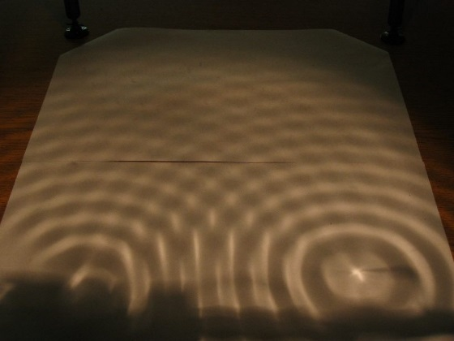
A single photon sees two balls
Y. Aharonov and L. Vaidman
Phys. Rev. A 67, 042107 (2003)
It scatters exactly
as if there were
two balls

Slide 30
A single ball closes two holes
Y. Aharonov and L. Vaidman
Phys. Rev. A 67, 042107 (2003)
It scatters exactly
as if there were
two balls

Slide 31
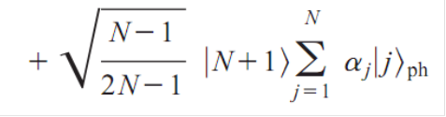
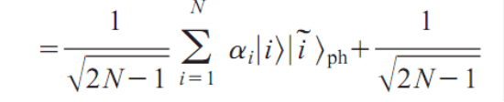
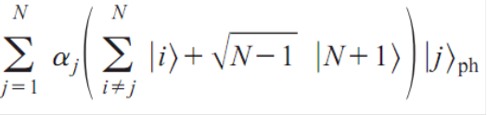
How to close N slits with one shutter?

Slide 32
How a spin can be both up and down?
What will happen in Stern-Gerlach experiment?

Slide 33
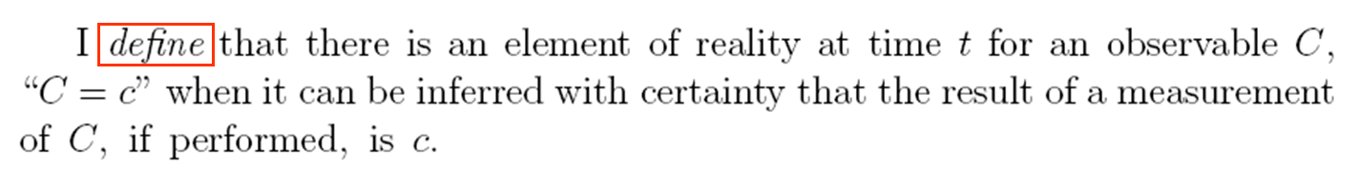
Elements of reality and Product rule

Slide 34
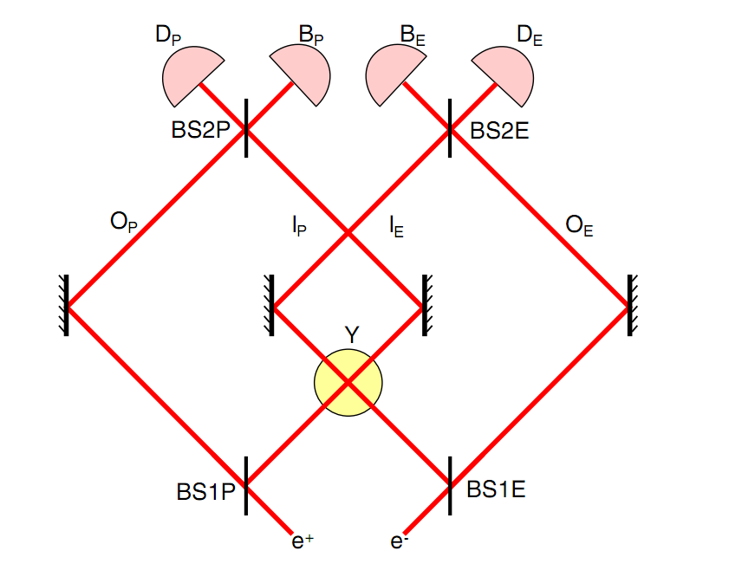
Hardy paradox
L. Hardy, PRL 68, 2981 (1992)
“if we assume realism and we assume that the ‘‘elements of reality’’ corresponding to Lorentz-invariant observables are themselves Lorentz invariant, we can derive a contradiction with quantum mechanics”
Failure of the product rule
L. Vaidman, PRL 70, 3369 (1993)

Slide 35
Peculiar example: a failure of the product rule

Slide 36
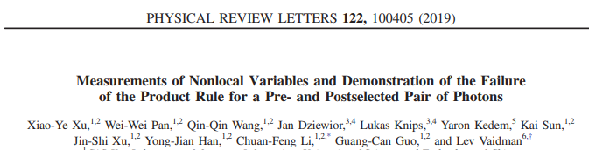
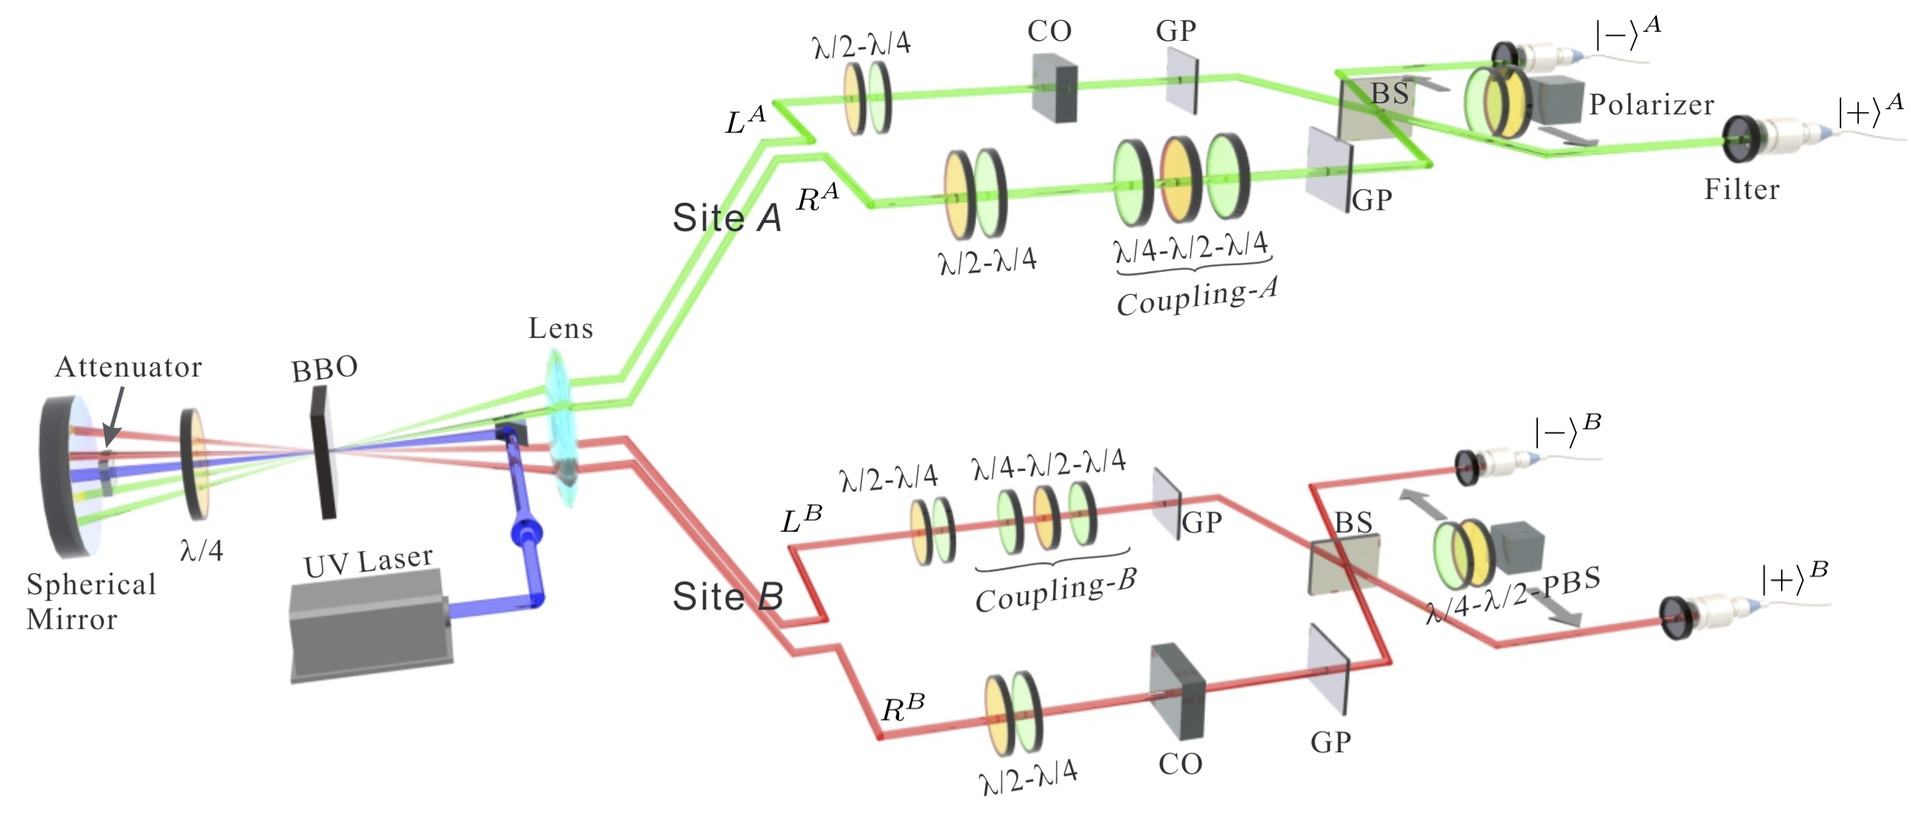
HYPERENTANGLED STATE

Slide 37
Any weak enough coupling to a variable C of a system described by is a coupling to a weak value

Slide 38
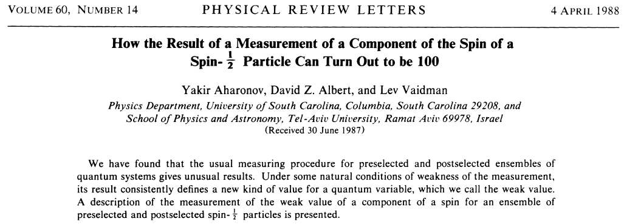
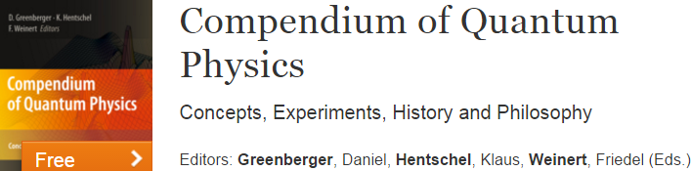
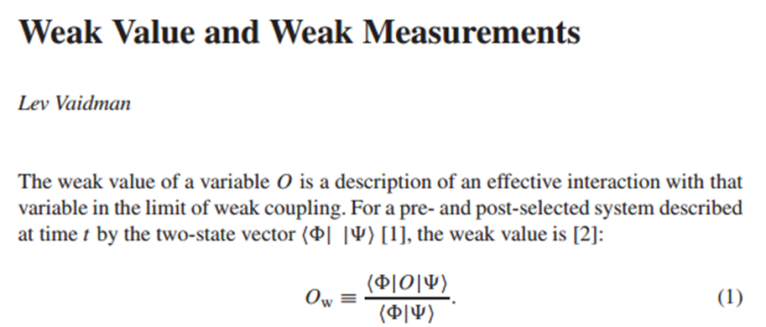

Slide 39
Weak value as an outcome
of a weak measurement

Slide 40
Quantum measurement of
Collapse!

Slide 41
Weak measurement of with post-selection

Slide 42
Weak measurement of with post-selection

Slide 43
Weak measurement of with post-selection

Slide 44
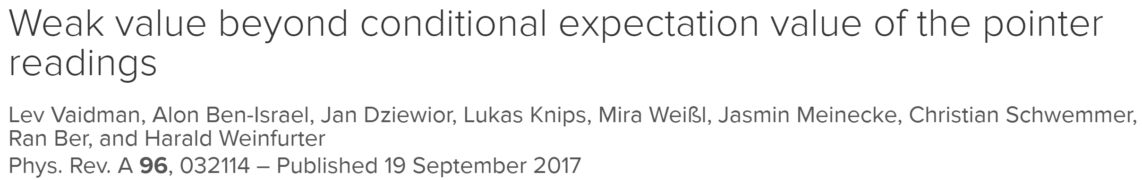
Weak value as a property of a single system
Weak value is more like an eigenvalue than like an expectation value

Slide 45
The weak value as a property of a single system
at a particular time t
is a complete description at a particular time t
is a complete description of coupling to C at time t

Slide 46
System: charged particle, variable: electric field at the origin
eigenvalue
expectation value
weak value

Slide 47
Comparing states of external system after
weak value
and
post-selected
The system is pre-selected
eigenvalue
The system is pre-selected
expectation value
The system is pre-selected
Bures angle distance

Slide 48
Experiment
visibility

Slide 49
Connection between strong and weak measurements
If is an element of reality then
For dichotomic variables:
If then is an element of reality

Slide 50
If is an element of reality then
For dichotomic variables:
If then is an element of reality
The three box paradox

