Slide 1
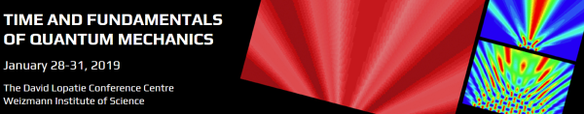
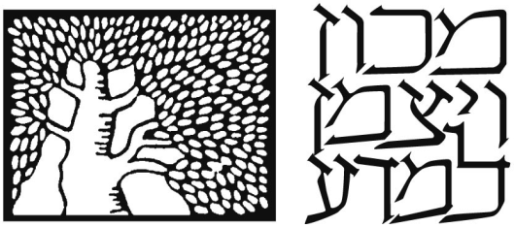



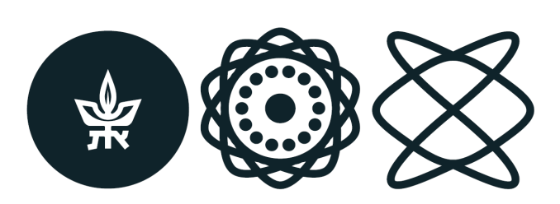


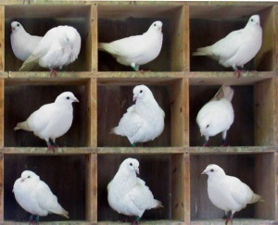
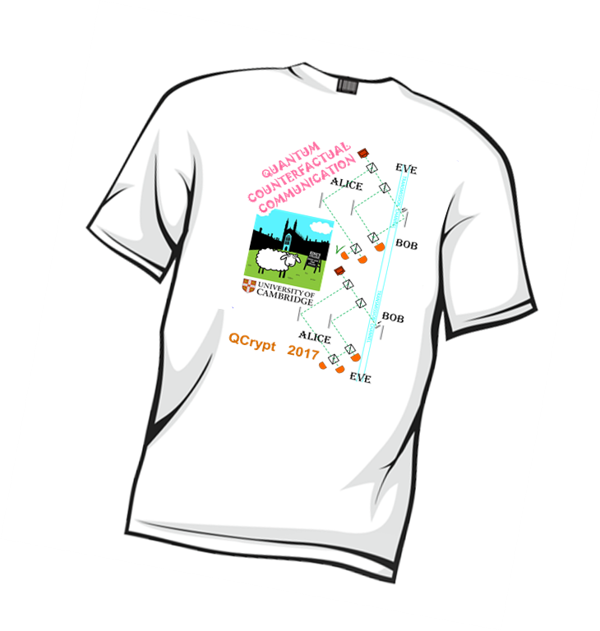
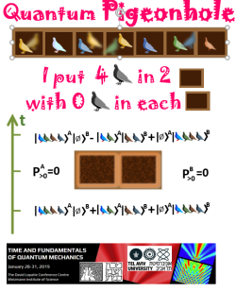

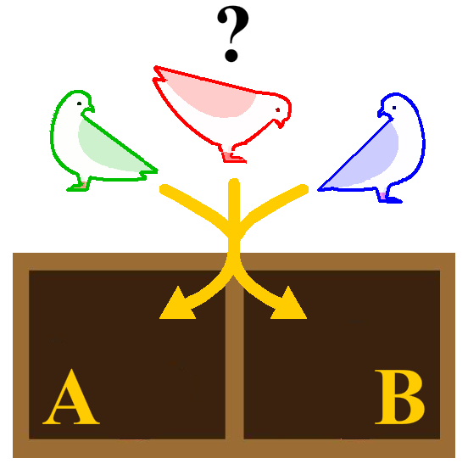

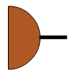



QUANTUM VIOLATION OF THE PIGEONHOLE PRINCIPLE
Gregory Reznik, Shrobona Bagchi, Lev Vaidman
PIGEONHOLE PRINCIPLE
IF N PIGEONS ARE IN M PIGEONHOLES, N>M, THEN AT LEAST ONE HOLE MUST CONTAIN MORE THAN ONE PIGEON
PIGEONHOLE CONTAINS MORE THAN ONE PIGEON
QUANTUM PIGEONHOLE PRINCIPLE
PIGEONHOLE DOES NOT CONTAIN MORE THAN ONE PIGEON
IF N PIGEONS ARE IN M PIGEONHOLES, N>M, THEN CANNOT BE TRUE FOR EVERY HOLE X
ELEMENTS OF REALITY OF PRE AND POSTSELECTED SYSTEM
QUIZ
t2
POSTSELECTION
t
GIVEN THE PRE AND POSTSELECTION PROBABILITY OF THE OUTCOME a IS 1
T- shirts for best solutions!
t1
PRESELECTION
1) Put (pre and postselect) four pigeons in two pigeonholes such that in hole A there will be all four pigeons and also in hole B there will be all four pigeons.
BREAKING THE PIGEONHOLE PRINCIPLE: PUTTING 4 PIGEONS IN 2 HOLES
t2
2 ) Put three pigeons in two pigeonholes such that there will be zero pigeons in hole A and also zero pigeons in hole B.
MOREOVER: EACH AND EVERY HOLE IS EMPTY!
3) Find all numbers N such that one can put N pigeons in two pigeonholes with zero pigeons in hole A and zero pigeons in hole B.
t
4) Find all numbers N such that one can put N pigeons in two pigeonholes with no more than K pigeons in hole A and also no more than K pigeons in hole B.
t1
PUTTING 3 PIGEONS IN 2 HOLES WITHOUT ANY PAIR IN HOLE A AND WITHOUT ANY PAIR IN HOLE B
t2
Y. Aharonov, S. Nussinov, S. Popescu, and L. Vaidman, Phys. Rev. A 87, 014105 (2012)
t
PIGEONS ARE IN HOLE X
t1
PUTTING 3 PIGEONS IN 2 HOLES WITHOUT ANY TWO PAIR IN THE SAME HOLE
Y. Aharonov, F. Colombo, S. Popescu, I. Sabadini, D. Struppa, and J. Tollaksen, PNAS 113, 532 (2016)
t2
t
PIGEONS ARE IN THE SAME HOLE
PIGEONS ARE NOT IN THE SAME HOLE
t1
SWITCHING OFF THE INTERACTIONS THROUGH QUANTUM PIGEONHOLE EFFECT
SINGLE BI-PARTICLE INTERACTION
WEAK ALL BI-PARTICLE INTERACTIONS TOGETHER
SWITCHING OFF INTERACTIONS IN EACH AND EVERY HOLE SEPARATELY
SWITCHING OFF IDENTICAL INTERACTIONS IN THE TWO HOLES
AHARONOV 2012
WEAK INTERACTIONS OF ALL PAIRS
WEAK INTERACTIONS OF ALL PAIRS
STRONG INTERACTION OF ONE PAIR
STRONG INTERACTION OF ONE PAIR
AHARONOV 2016
A
B
A
B
A
B
A
B
IF WITH CERTAINTY
Y. Aharonov and L. Vaidman, J. Phys. A: Math. Gen. 24, 2315-2328 (1991)

